Slide 1
PASSE Service Pathways for Members with Intellectual and Developmental Disabilities or Behavioral Health Needs
Rebalancing Towards Home and Community Based Services
Effective date 1/1/23

Slide 2
Provider-led Arkansas Shared Savings Entity (PASSE)
PASSE entities provide managed Medicaid services to youth and adults with individualized care needs in both institutional and home and community-based settings.
PASSEs Manage Services for 56,435 Arkansas
Individuals with Behavioral Health Needs (BH)
34,151 Children and Youth
14,848 Adults
Individuals with Intellectual and / or Developmental Disabilities (I/DD)
1,626 Children and Youth
5,810 Adults
PASSEs Manage Services for using 3 Medicaid Authorities
State Plan
1915(i) Home and Community Based Services (HCBS)
1915(c) HCBS

Slide 3
PASSE Members with Complex Needs
All PASSE members have more extensive needs than the general Medicaid population because of their diagnosis and the functional deficits
A smaller subset of the PASSE population have complex needs due to:
Involvement in multiple systems including justice system or child welfare
Have serious behaviors that threaten community safety
Have an intellectual disability and significant symptoms of a mental health condition

Slide 4
Stakeholder Input on the Challenge
DHS engaged stakeholders (providers, clients, families, legislators, and PASSEs) to assist with the identification of barriers to more effective service delivery within the PASSE.
DHS has designed a series of initiatives to address the challenges identified.
Structure of PASSE Program Policy and Regulations
Workforce Challenges
Policy and regulations are restrictive and complicated.
There are currently unresolved service gaps, e.g., evidenced based delivery of home and community-based services to address behavioral issues; this will allow us to shift away from a fee for service model of payment
Overall process and paperwork are administratively burdensome.
Difficulty for providers to hire and retain a workforce that provide PASSE services due to:
Lower wage levels that are not keeping pace with the market
Challenging clients with behaviors
Clients with low cognition that do not improve with typical Medicaid services and require more services in their homes and communities

Slide 5
The Service Mix for I/DD and BH Populations
DHS program staff and stakeholders identified the three challenges related to services available to PASSE members.
Some members often receive services that do not match their support needs.
Needed
Un-Needed
Under-utilized
Un-available
The large majority of PASSE members receive services they need.
Addressing these challenges will require efforts across the care continuum.
Development of Intensive In home for children, Assertive Community Treatment for adults, more Therapeutic Communities and more Community Reintegration programs. Also new Complex Care Homes for clients with IDD
Some members could benefit from services but are services are not being accessed.

Slide 6
Activities to Support PASSE Members with Complex Needs
Clearly defining and identifying the population
Creating a requirement in the PASSE agreement for Enhanced Care Coordination through a multi-disciplinary team
Creating a new level within an existing provider type that delivers home and community based service (HCBS) supervised by a professional (Intensive CSSP)
Adding new service definitions and billing codes for evidenced based HCBS led by professionals
Setting new comparison rates for existing services including Psychiatric Residential Treatment Facilities (PRTF) and special populations
Working on updating to current PRTF service manual to include level of service provision and quality services
Updated the daily rate for Therapeutic Communities service
Added Acute Crisis Unit beds for any AR Medicaid enrolled hospital to provide services to Medicaid beneficiaries age 4 and above
Through ARP funding, paying Workforce Stabilization Incentive Payments to HCBS providers, expanding current services, paying for evidenced based training, designing a statewide crisis response system, and piloting enabling technology for clients to remain safe in their homes

Slide 7
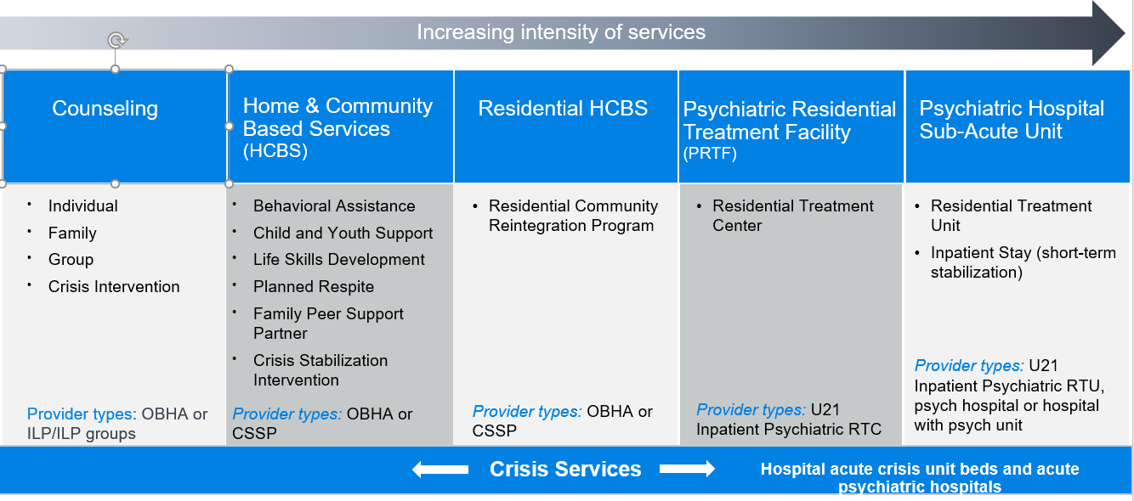
Child/Youth BH Currently

Slide 8
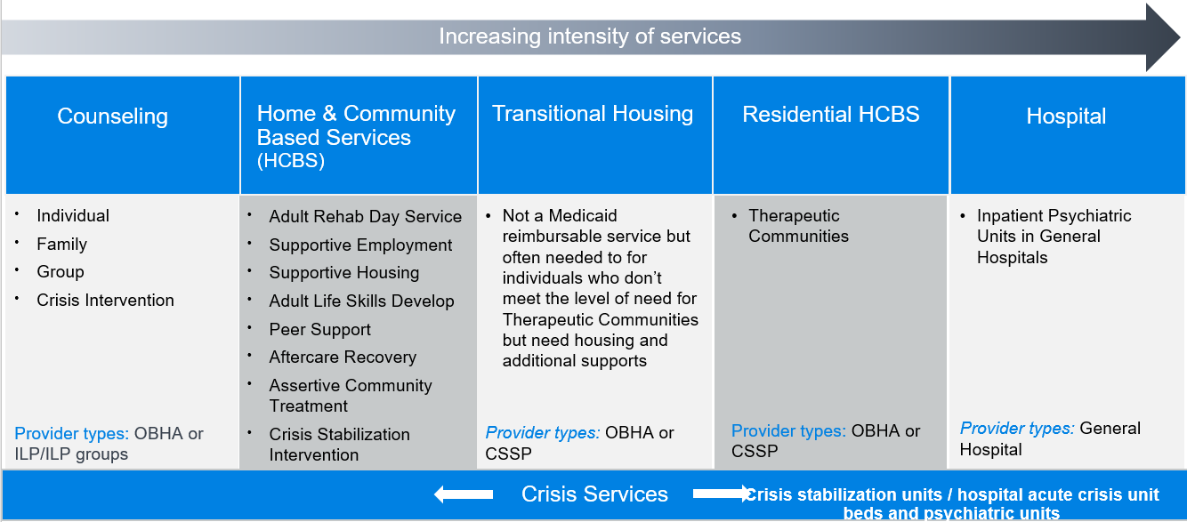
Adult BH Currently

Slide 9
Policy Changes
Outpatient Behavioral Health Agency Certification Manual
Move current service provider requirements to new CSSP level
Independently Licensed Practitioner Certification Manual
Sunset and allow providers to directly enroll
Outpatient Behavioral Health Services Manual
Change name Counseling Services Manual
Physicians Manual
Integrate behavioral health providers
Community Support Systems Provider Agency (CSSP) Certification Manual
Create 3 provider levels
Match service provider certification to align with HCBS array
Separate requirements for services that are overseen by professional
Under 21 Inpatient Psychiatric Services Manual
Add quality requirements
Add specialty populations

Slide 10
CSSP Certification: Three Levels
Enhanced and Intensive will require professional clinical oversight
Enhanced
Intensive
Base
Therapeutic Communities
Residential Community Reintegration Program
Complex Care Homes for IDD (up to 8 bed)
Assertive Community Treatment (ACT)
Peer Support
Aftercare Recovery Support
Intensive In-Home Services (ACT like service for children/youth)
Behavioral Assistance
Child and Youth Support
Family Support Partners
Crisis Stabilization Intervention
Adult Life Skills Development
Supportive Employment
Supportive Housing
Life Skills Development Individual and Group
Planned Respite
Supportive Living
Supplemental Support

Slide 11
Promulgation Timeline
Submit Final Draft to ORP in Jira 8/19
ORP Editing and Legal Review/Final Packet Prep 8/22-9/2
Executive Approvals 9/5-9/7
Go Live 1/1
Governor Review
9/15-9/29
Send Notice to ADG
9/30
File with BLR and SOS 9/30
*submit to CMS
Public Comment Period 10/2-10/31
Request Review and send Public Comment Summary to BLR 11/15
Legislative Approval/ Final Filing December
Deputy Director Review 9/8-9/12
Secretary Review 9/14
PRC 9/13

