Slide 1
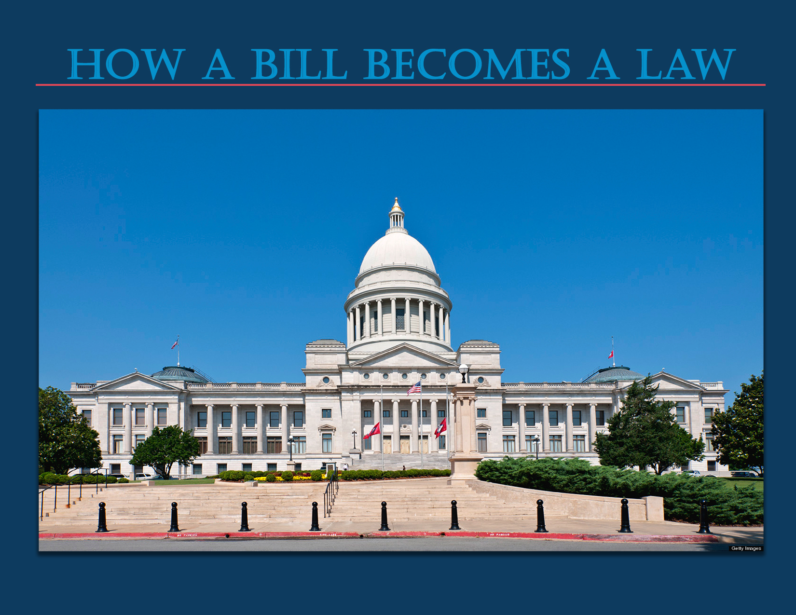

Slide 2
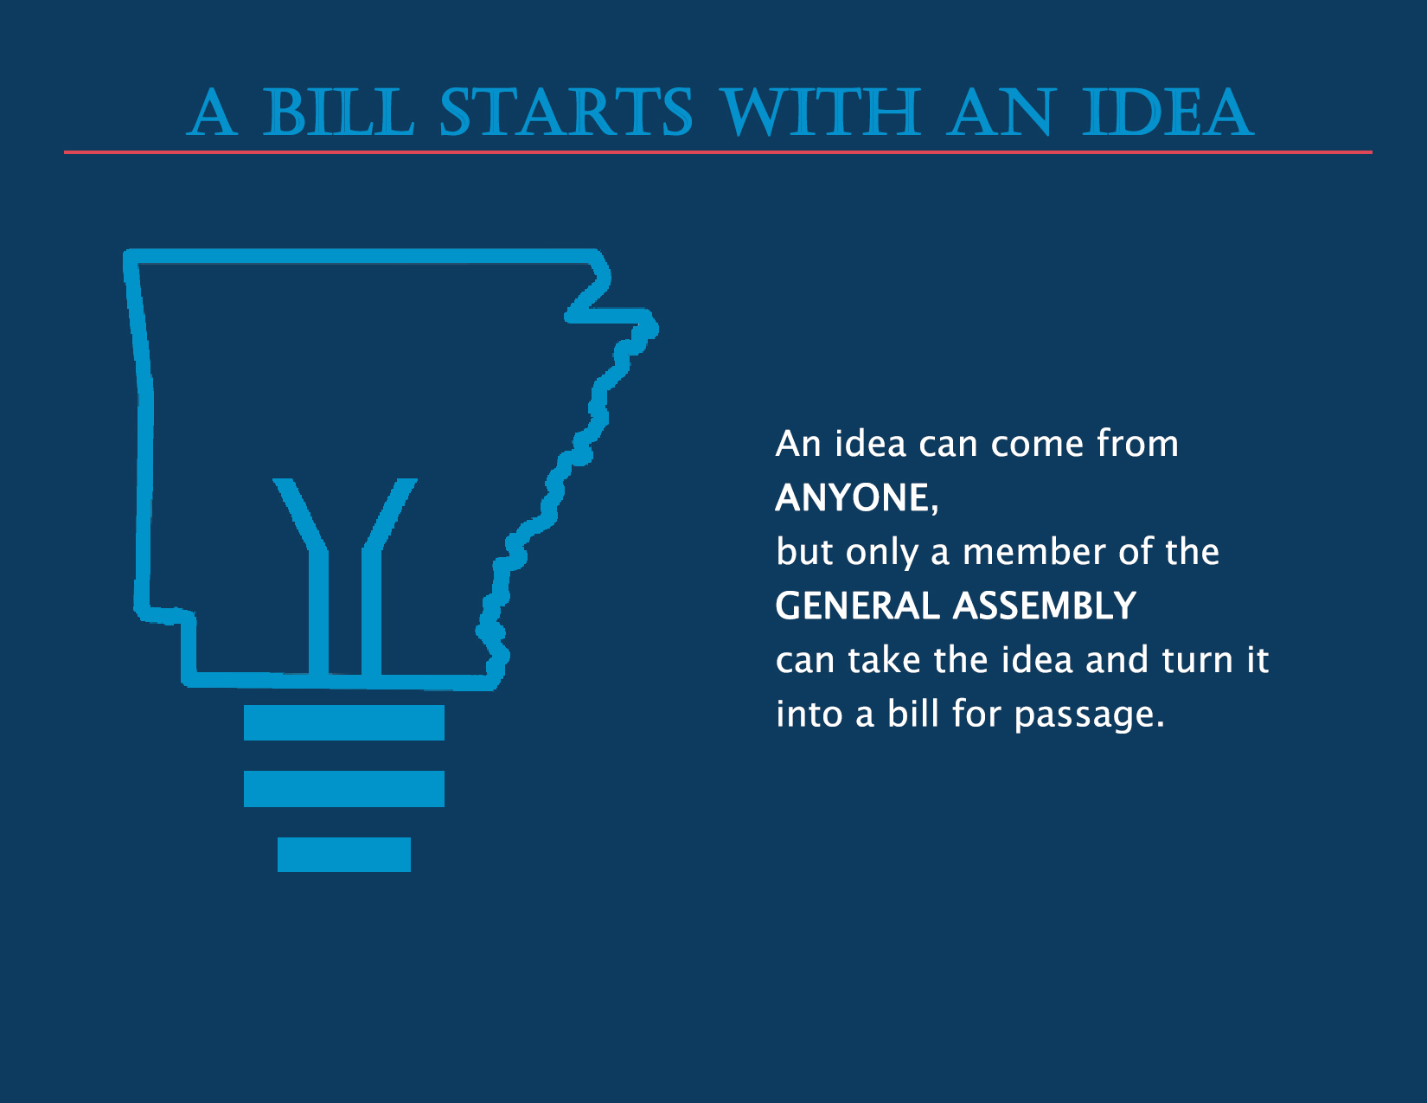
Notes:
An idea can come from anyone but only a member of the General Assembly can take the idea and turn it into a bill for passage.

Slide 3
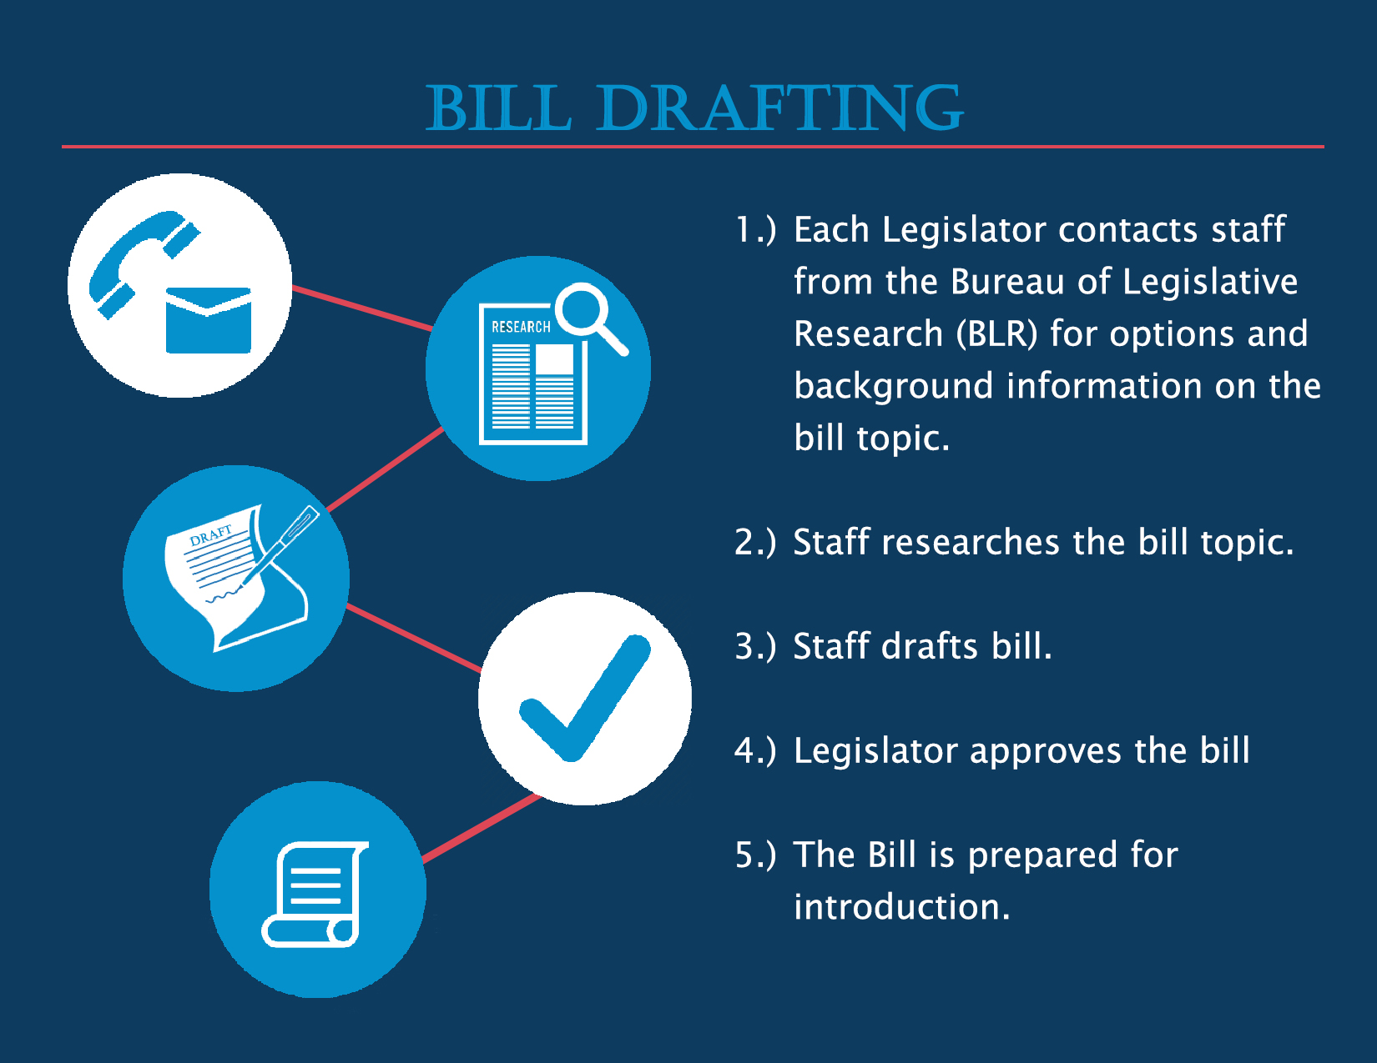
Notes:
All actual drafting of bills is done by the Bureau of Legislative Research. Drafting consists of putting the idea into proper language and format. Bills may have several revisions before the final draft is ready for introduction

Slide 4
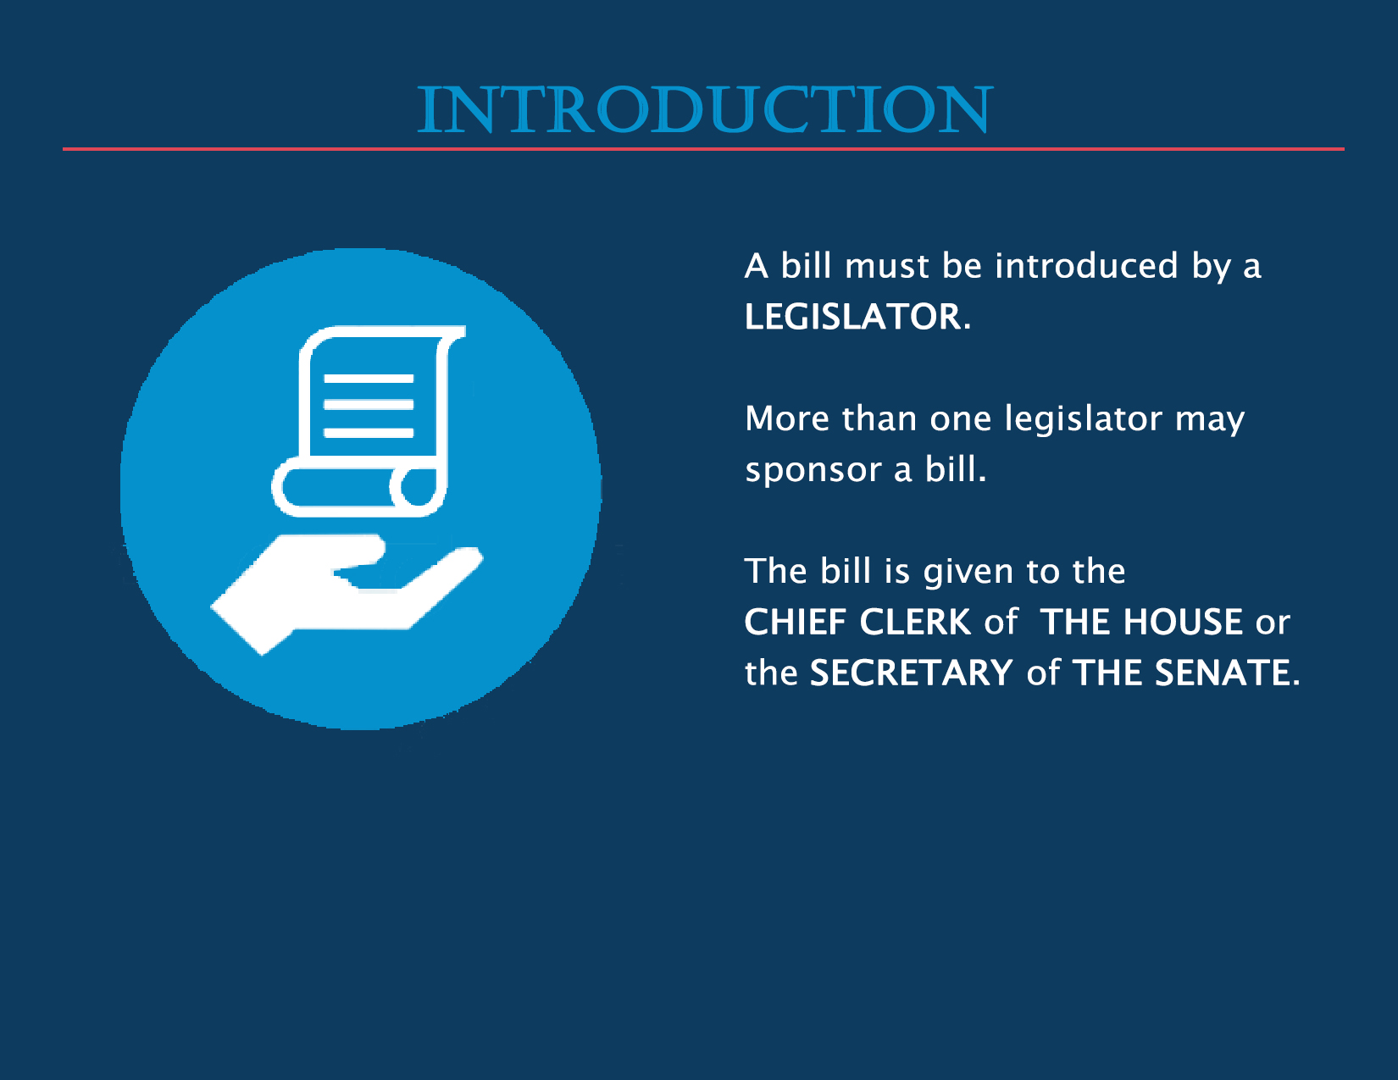
Notes:
Introduction of a bill can be made by any member of the House or Senate and more than one member can sponsor a bill. The bill is given to either the Chief Clerk of the House or Secretary of the Senate depending on the Chamber of origin.

Slide 5
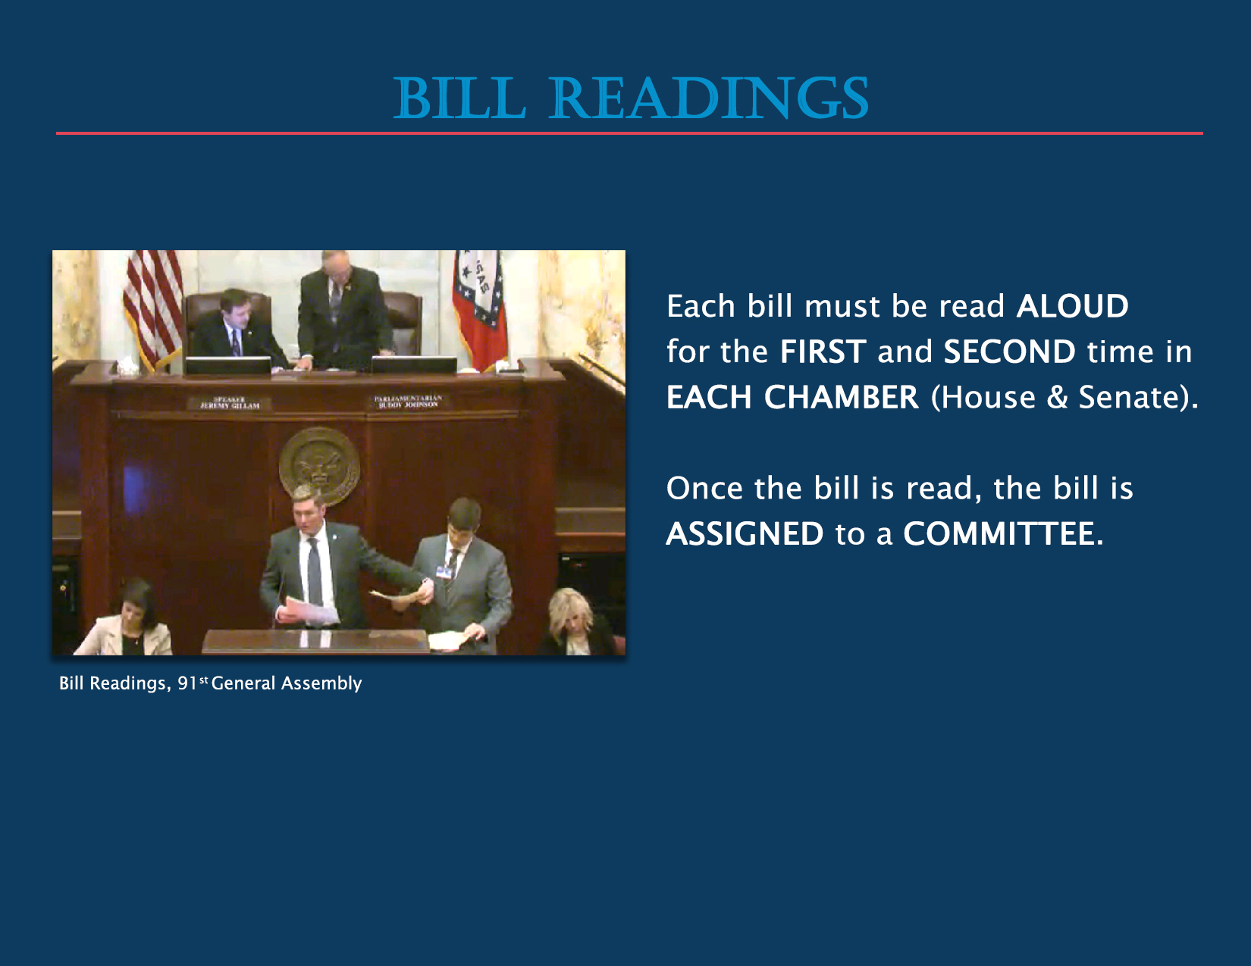
Notes:
Bills must be read aloud in each chamber. According to Article 5, Section 22, of the Arkansas Constitution a bill cannot be read three times and voted on in the same day. Rules can be suspended and a bill can be read two times in one day.
It is customary for the rules to be suspended and the first and second readings to occur on the first day. It is routine for only the bill title and number to be read unless members vote to have the entire bill read.

Slide 6
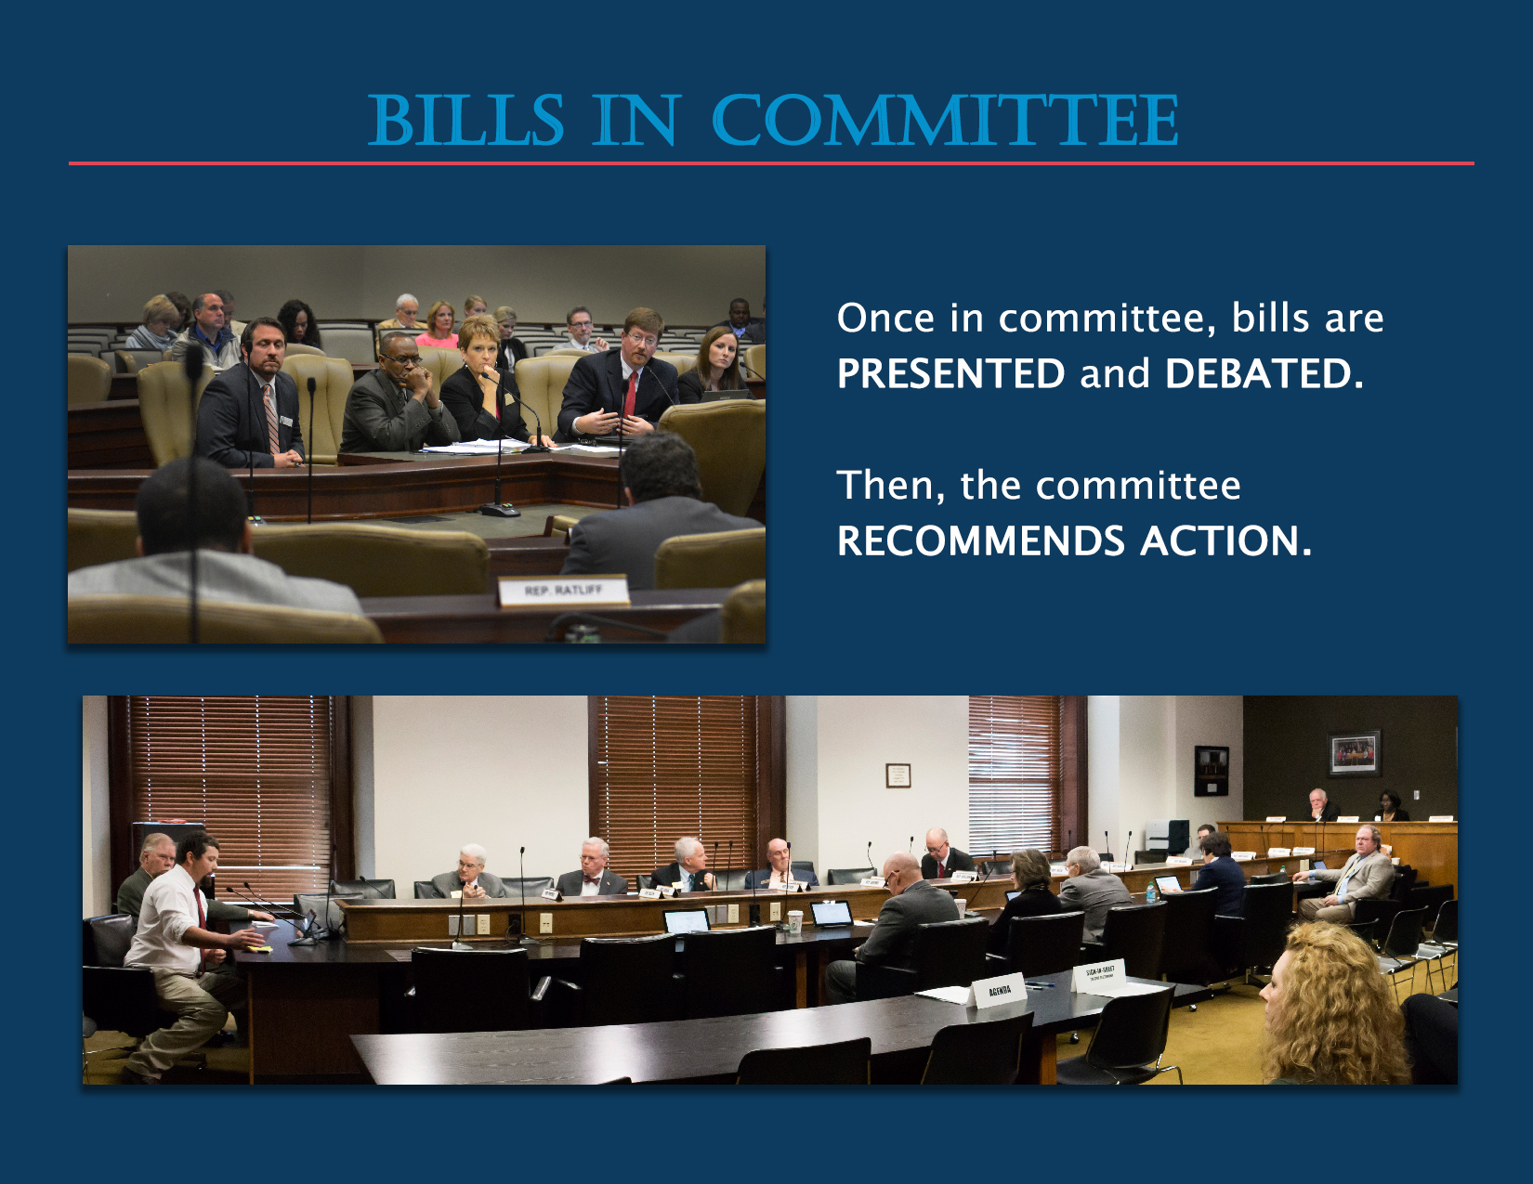
Notes:
A committee’s responsibility is to examine a bill and make recommendations. The House has 10 standing committees and the Senate has 9 standing committees.
There are also several joint committees made up of members from both the House and Senate.

Slide 7
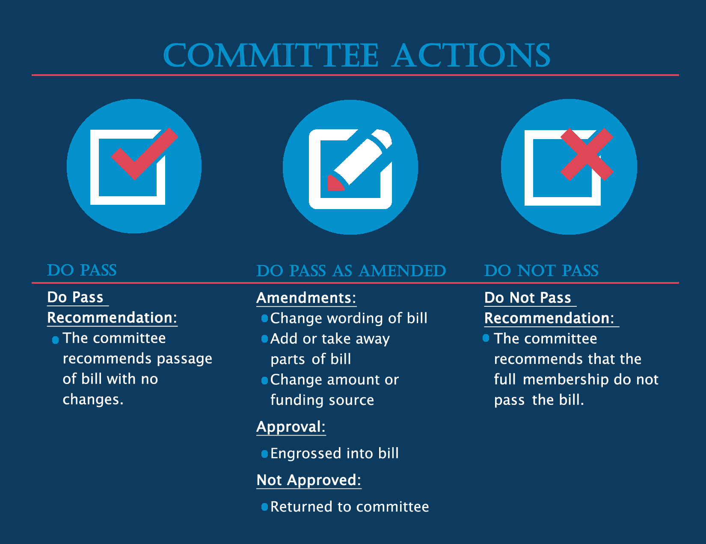
Notes:
Amendments are changes made to a bill. Amendments can be introduced in committee or in the chamber. A do pass as amended recommendation reflects that changes have been made to the original bill. Amendments must be voted on by the House and Senate membership.
If amendments are approved they are incorporated (engrossed) into the bill. If they are not approved the bill is returned to the committee.

Slide 8
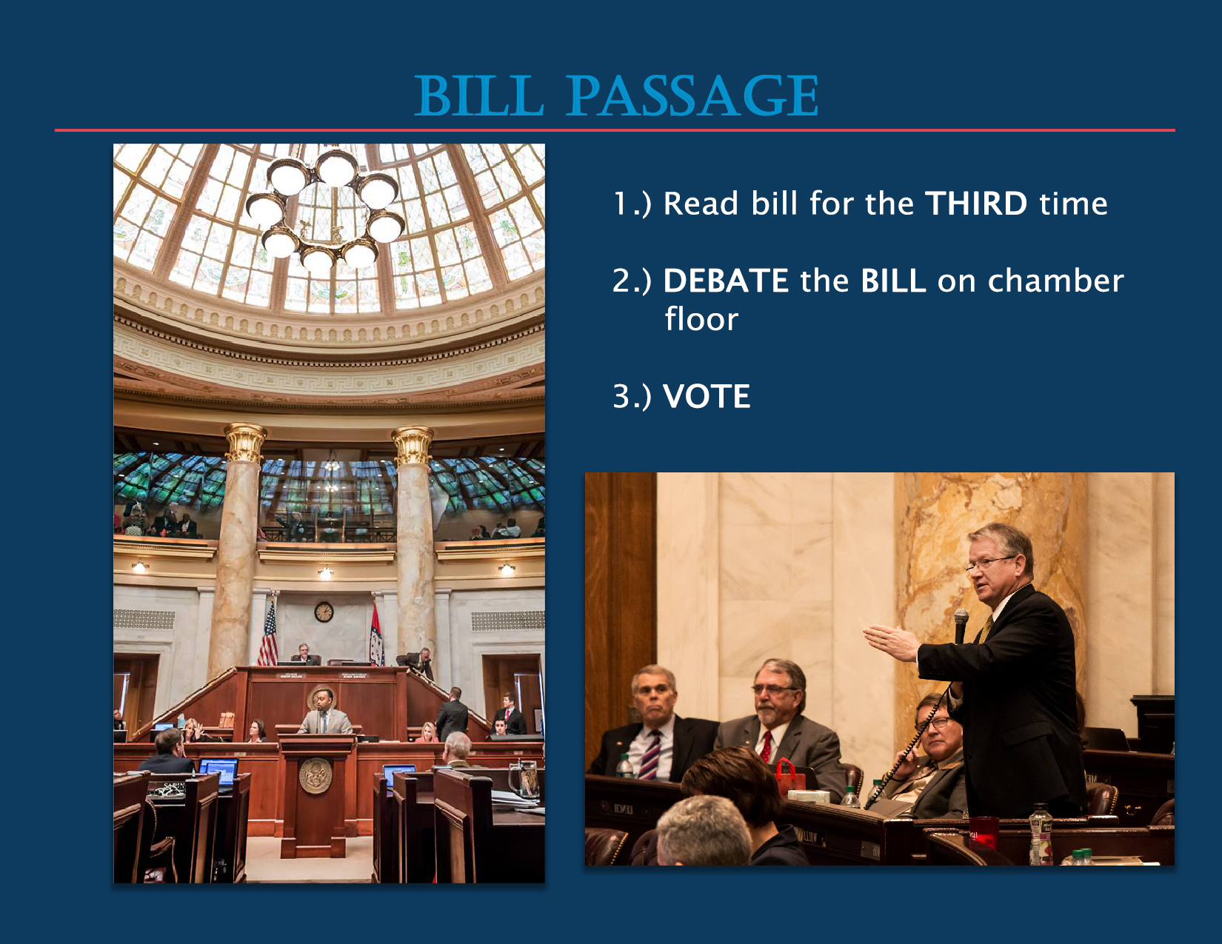
Notes:
Once a bill is returned by the committee it is ready for final passage. The bill is put into its final form with or without amendments. It is debated by the membership and then a vote is taken.

Slide 9
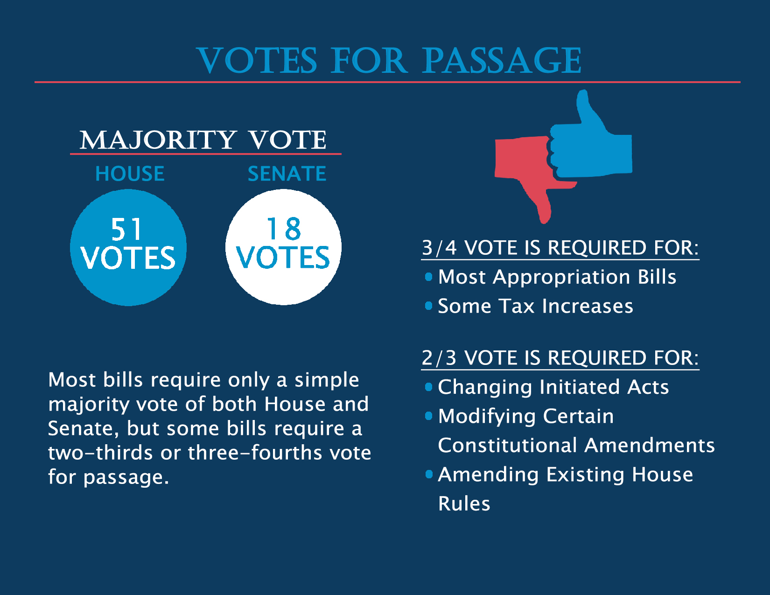

Slide 10
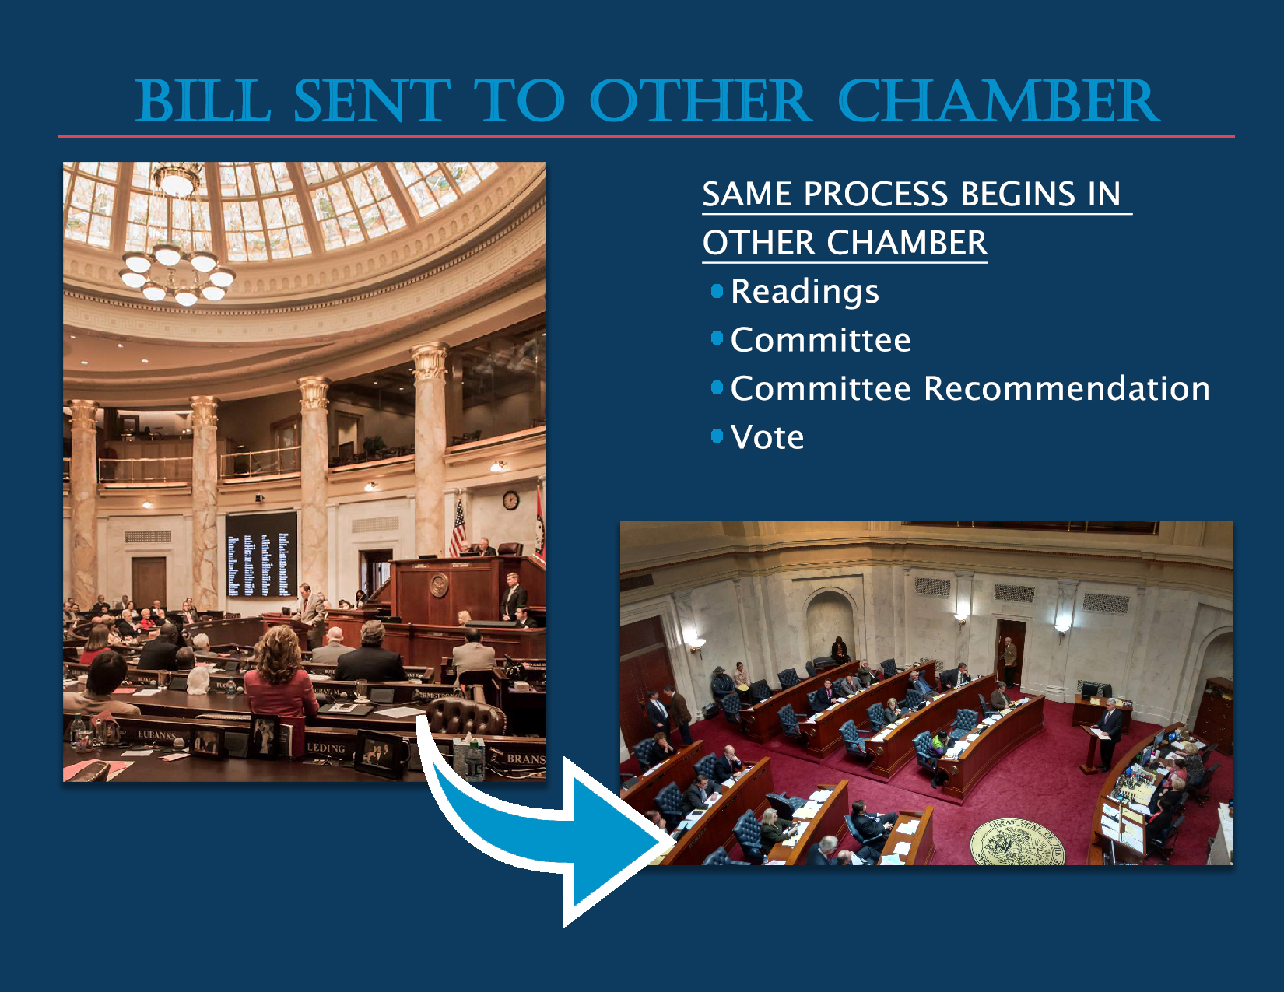
Notes:
Once a bill passes in the originating chamber, the bill is then sent to the other chamber and the same process begins.

Slide 11
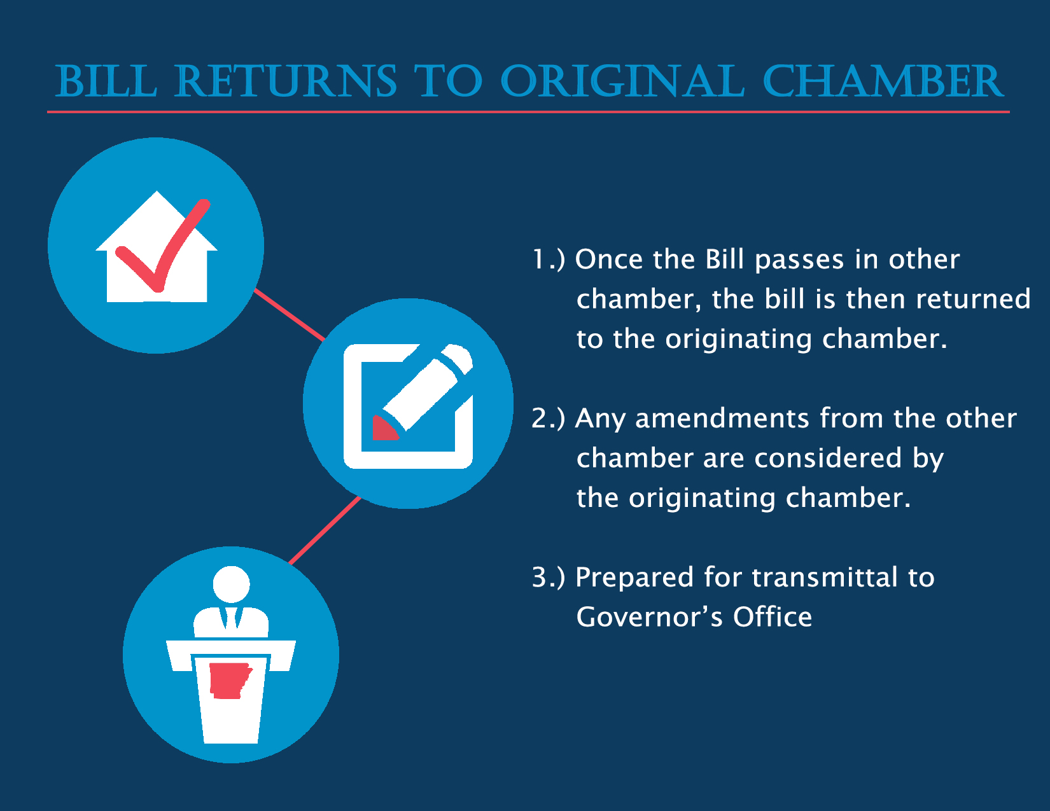
Notes:
Once a bill has passed the other chamber it is returned to the originating chamber. Any amendments that have been done by the other chamber are considered by the originating chamber. This process is known as a concurrence. If the amendments are accepted the bill is then prepared for transmittal to the Governor’s Office.

Slide 12
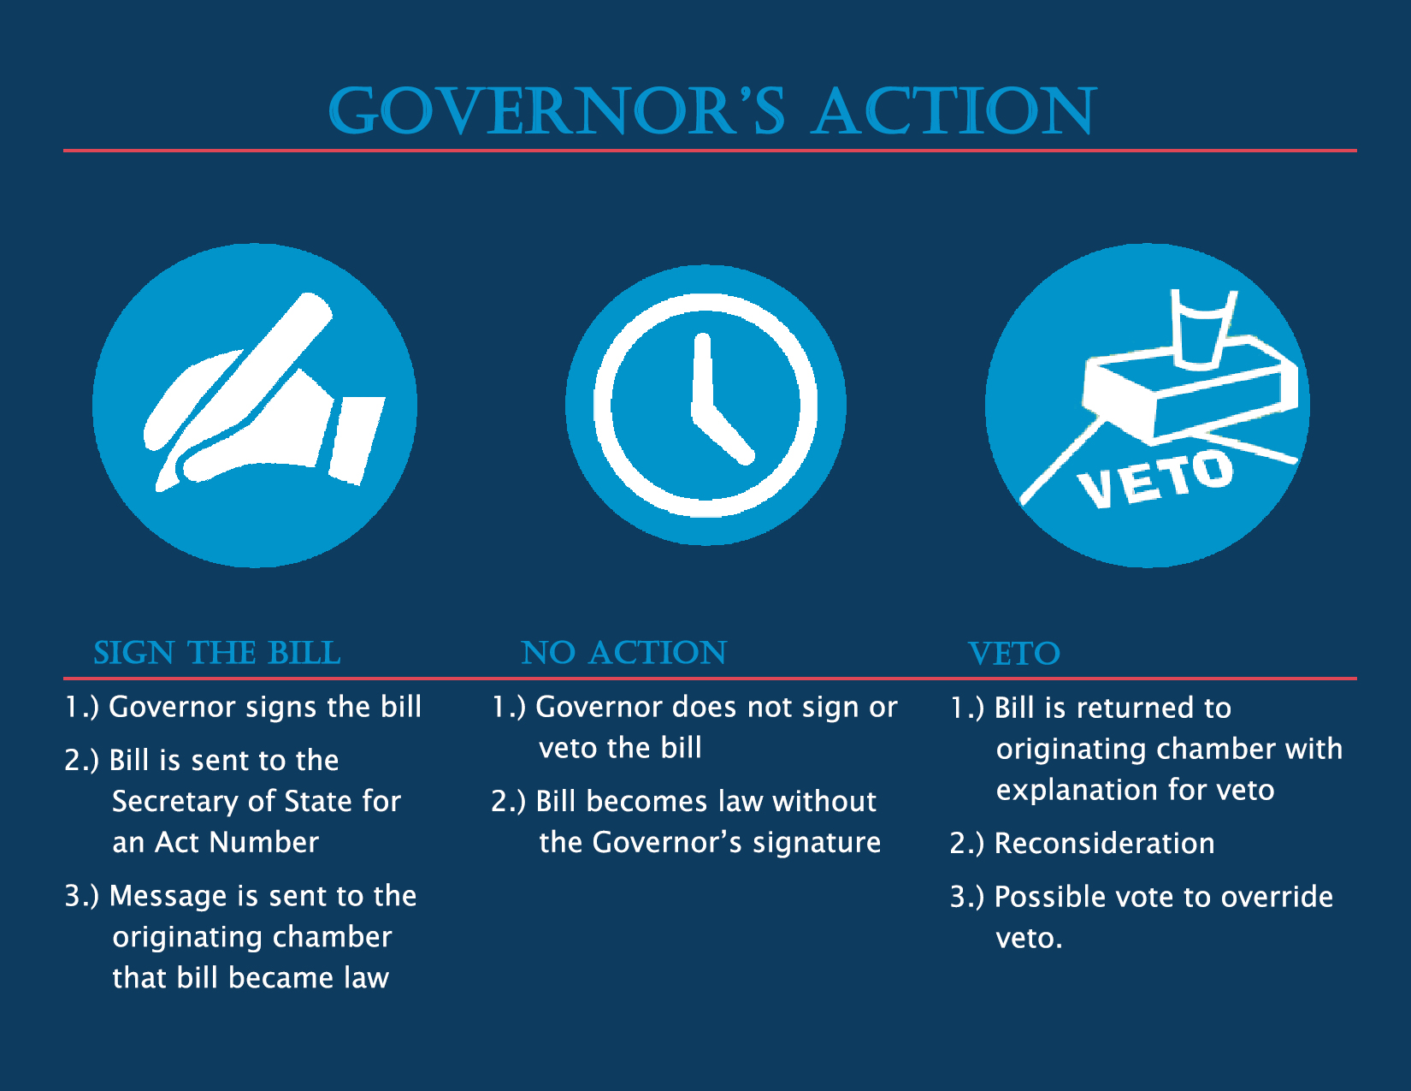
Notes:
Once the bill reaches the Governor’s Office three actions can take place. The Governor can sign the bill, take no action on the bill, or veto the bill.
Once the Governor signs a bill it is sent to the Secretary of State’s Office to be assigned an Act number. A message is also sent to the originating chamber that the bill has become a law.
If no action is taken after 5 days of reaching the Governor’s Office during session or 20 days after adjournment the bill becomes a law.
If the Governor vetoes a bill it is returned to the originating chamber with a letter explaining the reason for the veto. The bill can be reconsidered by both chambers. It takes a majority vote from both chambers to override a veto. If a majority is reached the bill then receives an act number. If the bill does not receive a majority vote then the bill dies. In some cases no vote is taken and the bill dies.

Slide 13
Arkansas Budget and
Appropriation Process
Fiscal Services Division
1 Capitol Mall, 5th Floor

Slide 14
The Budget Process
PREPARATION
REVIEW
AUTHORIZATION
FUNDING
Notes:
The Budget Process is a series of components that feed into one another.
This process can be broken down into four basic to a budget process:
Preparation
Authorization
Funding
Review/Revise
We will address each of them in turn.

Slide 15
Regular Session Budget Calendar
PREPARATION
Jun
Jul
Aug
Sep
Oct
Nov
Dec
Jan
Feb
Mar
Apr
May
Jun
Budget Requests Prepared
Executive
Review
ALC/JBC
Hearings
Official Revenue
Forecast
Session Convenes
Joint
Budget Meetings
Legislature Adjourns
Operating
Budgets
Prepared
Notes:
Regular Sessions start in January of odd number years, but the events begin prior to January.
The first event occurs during June and July when the agencies receive the budget request forms and instructions from the Governor and the Department of Finance and Administration (DFA).
The DFA Budget Office and the Governor review the agencies’ requests beginning in July and continuing through November.
The hearings of the Arkansas Legislative Council (ALC) usually begin in the first week or so of October. The Joint Budget Committee (JBC) sits with the ALC as voting participants in the hearings, creating the Arkansas Legislative Council/Joint Budget Committee (ALC/JBC). Each agency which received an appropriation by the last legislature presents its request for the next biennium.
The Director of DFA is required by law to present the Official General Revenue Forecast and balanced budget no later than 60 days prior to the beginning of the regular session.
The formal agency and institution presentations are completed in November but the recommendation process by the ALC/JBC normally isn’t completed until shortly before the convening of the legislative session, which is on the second Monday in January.
Once the regular session convenes the Joint Budget Committee begins meeting to consider budget revisions and new requests throughout the session. By rule, the Joint Budget Committee introduces the ALC/JBC recommendations as the appropriation measures for the next fiscal year.
The Legislature usually adjourns in April.
The agencies then prepare their operating budget for the next fiscal year which starts on July 1.

Slide 16
FISCAL SESSIONS - Budget Calendar
Have different starting dates depending on when elections are held
Pre-fiscal session budget hearings: Budget hearings tentative dates are all day 9am to 4:30pm, with a break for lunch, on Tuesdays, Wednesdays and Thursdays in the first two weeks of March.
Pre-filing: Pre-filing begins the second Monday of January of each year of a fiscal session of the General Assembly which is held in a year in which the preferential primary election is held in May (this is the 2022 Fiscal Session) and the second Monday of March of each year of a fiscal session of the General Assembly which is held in a year in which the preferential primary election is held in March (this is the 2020 Fiscal Session).
Convening of fiscal session:
The General Assembly shall meet in a fiscal session at 12:00 noon on the on the second Monday in February in the years in which the preferential primary election is held in May (this is the 2022 Fiscal Session) and on the second Wednesday in April in the years in which the preferential primary election is held in March (this is the 2020 Fiscal Session). This rule is derived from Arkansas Constitution, Article 5, § 5, which permits the General Assembly to establish the dates of a Fiscal Session.
Deadline for filing Identical Resolution for non-appropriation bills: Joint Rules state that identical resolutions may not be filed later than the first day of each fiscal session. A two-third (2/3) vote is required by the General Assembly.
Deadline for filing appropriation bills: Joint Rules state: The deadline for filing appropriation bills is no later than the fifteenth (15th) day of the fiscal session. In order to extend the deadline, a two-third (2/3) vote is required by the General Assembly. Deadline for filing General Legislation or non-appropriation bills that have been approved with the passage of Identical Resolutions.
Length of fiscal session:
Arkansas Constitution, Article 5, § 17 states that the fiscal session shall not exceed thirty calendar days in duration.
* The fiscal session may be extended one-time not to exceed fifteen calendar days by a vote of three-fourths (3/4) of the General Assembly.
Notes:
Amendment 86 to the Arkansas Constitution authorized annual sessions, with the first Fiscal Session being held in 2010.
Regular Sessions are held during odd numbered years and Fiscal Sessions during even numbered years.
The Fiscal Session process is similar to the Regular Session process with the following exceptions:
Amendment 86 states a fiscal session shall not exceed thirty (30) calendar days in duration, except that by a vote of three-fourths (3/4) of the members elected to each house of the General Assembly a fiscal session may be extended one (1) time by no more than fifteen (15) calendar days.
Appropriation bills are only considered during the fiscal session. A bill other than an appropriation bill may be considered in a fiscal session if two-thirds (2/3) of the members of each house of the General Assembly approves identical resolution for consideration of the bill.
The Legislature adjourns no later than 45 days from the convening of the session.

Slide 17

Executive
Roles in Budget Preparation Phase
PREPARATION
The Executive:
Set Policy for Agency Requests
Review Agencies Requests and make an Executive Recommendation
Forecast State Revenue
Recommend Balanced Budget
Recommend Revenues as Needed
Governor/DFA
Notes:
The Governor is expected to recommend a balanced budget and to provide a clear objective based upon his or her personal and political goals for next biennium’s spending.
By policy directives, public pronouncements and private meetings, the Governor drives the process and directs the topics of the discussions. The roles of the Governor and Department of Finance and Administration in the process are to:
Set policy for the agencies requests.
Forecast available revenue.
Recommend a balanced budget.
Recommend additional revenues or revenue reductions to meet the budget recommendations.

Slide 18


Legislature
Roles in Budget Preparation Phase
PREPARATION
Budget Hearings
ALC/JBC MEMBERS
Regular Session (odd numbered years)
ALC/JBC or JBC:
Consider Agency Requests & Governor’s Recommendation
Recommend Budgets to General Assembly
Recommend Authorized Positions, Titles & Grades
Recommend Special Language
Have Bills Prepared for Introduction
JBC MEMBERS
Fiscal Session (even numbered years)
Notes:
Regular Session: The members of the Legislative Council and the Joint Budget Committee meet every other October through December before Regular Sessions and hold public hearings so that recommendations can be made to the General Assembly. Each agency head appears before the committee and presents his or her budget, any change levels requested and their reaction to the Executive (Governor’s) Recommendation, if any.
Fiscal Session: The Joint Budget Committee meets in January of even numbered years before Fiscal Sessions. These budget hearings automatically consist of the “big 6” general revenue agencies and other agencies may be heard after receiving approval from the Legislative Council or requested by the Joint Budget Committee.
During the Budget Preparation Phase these Budget Committees:
Considers the agency and Governor’s requests.
Recommends spending levels to the General Assembly.
Recommends state employee salary levels and pay policies.
Directs the preparation of appropriation bills with recommendations of the committee.
Agency and Institutions officials often protect existing services or programs which may require request for additional resources to account for inflation or potential additional requirements.
Legislators may appreciate some social and political benefits of spending public money but will also view some proposals as unneeded expenditures from the public treasury by the executive. The Legislature is often viewed as guardians of the Treasury from these officials.

Slide 19
Budget Hearings = Appropriation Bills
PREPARATION
Appropriation bills for each State Agency and Institution of Higher Education are drafted as approved in Budget Hearings.
Arkansas Legislative Council & Joint Budget Committee (ALC/JBC) conducts budget hearings for Regular Session and Joint Budget Committee (JBC) conducts budget hearings for Fiscal Session.
The Appropriation bills will have:
  Numbers of Positions as recommended (in a report) by the Personnel Subcommittee and adopted by the full committee.
  Special Language as recommended (in a report) by the Special Language Subcommittee and adopted by the full committee
  Appropriation levels or spending authority as adopted by the full committee.

Slide 20
AUTHORIZATION
APPROPRIATION
AN APPROPRIATION GIVES THE AGENCY THE AUTHORITY TO SPEND MONEY IF AND WHEN IT BECOMES AVAILABLE.
Notes:
IN ARKANSAS, AUTHORIZATION IS APPROPRIATION.
Appropriation provides the authority for a State Agency or Institution to spend money, but that spending authority is not money or funding.
The granting of an appropriation does not confer the right to money

Slide 21
The Authorization Phase
AUTHORIZATION
Elements of an Appropriation
Appropriation
For Who:
Which State Agency or
which Higher Education Institution?
Where “$”:
Where will the money come from?
What type of fund?
For What:
What will the money be used for?
Must be a specific purpose.
How Much:
What is the maximum amount authorized and for what time period?
Notes:
Although there are several types of Appropriation Bills, they each contain the same characteristics and share the same elements.

Slide 22
Appropriation Section in Bill
Appropriation Bill
Funded From Where/Source
Who
For What Purpose
Total Amount Spending
Authorized
Notes:
Each bill must specify:
Who is given the authority to spend the funds.
The source of the funds to be spent.
The purpose for which the funds may be spent.
The maximum amount of funds authorized to be spent for a period of time.
Which then leads to examining the designated source of the funds authorized to be spent.

Slide 23
Standard Appropriation Bill
for State Agencies Positions & Operating Expenses
Appropriation Bill
Session
Extra Help
Section
Sponsor
Title
Subtitle
Appropriation
Section
Regular Salary
Section
Special
Language
Section
Notes:
What appropriation bill looks like.

Slide 24
Types of Appropriation Bills
AUTHORIZATION
Regular Appropriation
  1-year period
  Effective July 1
Supplemental Appropriation
  Effective before July 1 & usually immediately
  Usually adds to an existing authority
  State Funds usually come from an Accumulated Surplus
Notes:
An Appropriation Bill is one that authorizes the spending of money either from the State Treasury, as required by the Arkansas Constitution, or from bank accounts under the control of the various agencies.
Regular Appropriations
Are drafted for a one year period.
Are drafted for the upcoming Fiscal Year. Effective July 1 through June 30.
Every State Agency, Board, Commission and Institution of Higher Education must have an appropriation bill to be able to spend money and operate. With the exception of the Lottery Commission which was purposefully established with spending authority outside of the state appropriation process.
Supplemental Appropriations
Are effective before July 1 & usually immediately for the current fiscal year.
Usually adds to an existing authority or addresses a previously unforeseen need.
This may just provide additional spending authority if the Agency already has funding available or if the Agency also needs funding these funds usually come from a surplus.

Slide 25
AUTHORIZATION
Construction
  State Funds usually from General Improvement Fund (Surplus & Interest Earnings)
Reappropriations
  Allows the Agency to spend the balance of an appropriation provided by another General Assembly.
  Not new authority to spend
  Usually for old construction projects
Notes:
Construction Appropriation Bills
Usually appropriation for the upcoming fiscal year and are for a one-time expense and not ongoing expenses.
Funding is usually from the General Improvement Fund (which consists of Surplus & Interest Earnings)
Reappropriations
Allows the Agency or Institution to spend the balance of an appropriation previously provided by the General Assembly.
Not new authority to spend and no additional funding.
A reappropriation must be for the exact same purpose and equal to or less than as the original appropriation.
Usually for old construction projects which allows the Agency or Institution to spend existing fund balances.

Slide 26
Authorization Phase –
Constitutional Restrictions
AUTHORIZATION
1 Year Limit on Appropriations.
Single Subject.
General Appropriation Bill must "embrace nothing but appropriations for the ordinary expenses of the executive, legislative and judicial departments of the state” & be passed first.
Appropriations must be in dollars and cents.
Appropriations require 3/4ths vote to pass.
Notes:
The differences between the various states’ budget processes and procedures are a direct result of tradition and requirements of the State’s Constitution. Our State Constitution puts some very strict requirements on enacting the budget.
There is a one year limit on appropriations. One legislature can't bind another. Each General Assembly makes its own budget.
The appropriation bill must have only one subject. The courts have ruled that the word "subject" is very narrow. Therefore, we have an appropriation bill for every agency. This results in Arkansas leading the nation in the number of appropriation bills. Last Regular Session we had over 750 bills appropriating money compared to 1 to 5 for most states.
We must pass the bill for the expenses of the elected constitutional officers before any other appropriation bill is passed for the next biennium. This bill is commonly referred to the “General Appropriation Bill”. We failed to do that in 1989 and had to have a special session to reenact every appropriation measure passed during the regular session.
Appropriations must state a maximum amount and can't be open ended.
Appropriations require 3/4ths of the vote in both the House and Senate to pass.

Slide 27
During Legislative Session
The Joint Budget Committee:
Consider ALC/JBC Recommendations – During Regular Session
Consider JBC Recommendations – During Fiscal Session
Consider Governor’s Revisions and New Programs
Consider Member-Sponsored Bills
Recommend Fiscal Bills and Pay Levels to General Assembly
Prepare Revenue Stabilization Amendment
Can Prepare a General Improvement Fund Bill or Rainy Day Bill
Joint Budget Committee
Notes:
After the Budget hearings and during both the Regular and Fiscal session the members of the Joint Budget Committee meet to:
Evaluate and consider the ALC/JBC recommendations, made during budget hearing, before recommending the bills to the general assembly.
Consider any Governor’s proposed changes and new initiatives.
Consider individual member sponsored bills.
Recommend various fiscal law changes and state employee pay level legislation to the general assembly.
Recommend an amendment to the Revenue Stabilization Law to determine General Revenue spending.

Slide 28
Now that there is Appropriation or Spending Authority where does the money or funding come from?
Funding for Appropriation Bills
FUNDING
Notes:
Providing a source of funds to be spent is the next step in the process. State Agencies receive resources from a variety of places. The provision of actual dollars to an agency to be spent is called "funding". “From Where” indicates the Source of funds that are authorized to be spent. The State Constitution requires that an appropriation be enacted before the funds can be expended.

Slide 29

FUNDING
SPENDING IS LIMITED BY THE AVAILABLE APPROPRIATION OR THE AVAILABLE MONEY - WHICHEVER IS LESS!
Appropriation
Funding
Notes:
The maximum amount that an agency can spend from any source depends upon the amount of appropriation AND the amount of real dollars.

Slide 30
Methods of Funding Available
To Fund Appropriation Bills that
Authorize Expenditures for State Programs/Services
General Revenue & Revenue Stabilization Act (RSA)
Tax Collections
Distributed through the Revenue Stabilization Act (RSA)
Source/Method to fund Programs, Agencies & Institutions
Dedicated Source
  Special Revenue
  Federal Funds
  Cash Funds
  Trust Funds
One Time Funding
Surplus
Recouped General Revenue
FUNDING
Notes:
There are various methods of funding available for State Agencies, Boards, Commission, Institutions of Higher Education and improvement projects. The next section of this presentation examines the major sources by dedicated revenues, general revenues and one time funds.

Slide 31
GENERAL REVENUES
Funds received by the State from fees and taxes levied on the general population of the state.
The proceeds are not designated to be used for a particular purpose but are allocated every year by acts of the General Assembly.
Interest earnings are retained in the State Treasury.
3% to 4% deducted for administrative service charge
Legislature distributes funds each year through Revenue Stabilization Law for operating budgets
Recovered fund balances usually authorized for supplemental, rainy day and construction fund (exceptions are Education and Higher Education Institutions)
Some Examples: Sales tax, Income tax, Insurance premium tax, Racing taxes, Alcoholic beverages
FUNDING
Notes:
Taxes levied on the General Population with no restrictions on usage by law.
Some Characteristics are:
3% to 4% deducted for administrative service charge
Interest earnings go to construction and loans
Legislature distributes funds each year through Revenue Stabilization Law for operating budgets
Recovered fund balances usually authorized for supplementals and construction fund (exceptions are Education and Higher Education Institutions)
Same Examples:
Sales tax
Income tax
Insurance premium tax
Racing taxes
Alcoholic beverages

Slide 32
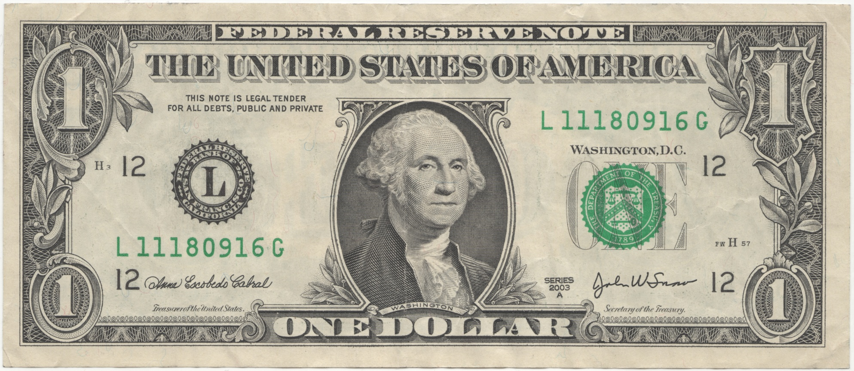
What your Arkansas tax dollar pays for
44 ¢
Education
Kindergarten through 12th Grade
27 ¢
Department of Human Services and Health Department
14 ¢
Higher Education Institutions
8 ¢
Correction Dept. and Community Correction Dept.
7 ¢
General Gov’t
& Local Aid
Funding
Excludes “off the top” deductions such as refunds, claims, debt services, constitutional offices, etc.
Notes:
To help visualize how tax dollars are distributed, this chart shows the purpose for which each tax dollar (net general revenue) is allocate.
After Off the Top deductions such as claims and refunds are paid, general revenue (tax dollars) available for distribution flow to Agencies and Institutions as determined by the General Assembly. The Public School Fund and General Education make up the largest distribution of state tax dollars available. The Department of Human Services combined with the Health Department are the next largest followed by all 32 Institutions of Higher Education, and then followed by Correction services (Department of Correction and Department of Community Correction). That leaves approximately seven cents of each dollar available for other General Government and Local Aid distributions.

Slide 33
FLOW OF GENERAL REVENUE
INCOME or TAX COLLECTIONS:
Sales and Income Taxes account for
over 92% of Gross General Revenue Collections
“OFF THE TOP” DEDUCTIONS
Deductions required by law such as claims against the State and tax refunds are distributed before funds are made available to State Agencies and Institutions
RSA
DISTRIBUTION OF GENERAL REVENUE THROUGH
Revenue is Distributed to Agencies & Institutions up to the amount Forecast as allocated in the Revenue Stabilization Act (RSA).
Approximately 93% Net General Revenue are distributed to the “BIG SIX”, which consists of Education-Public School Fund, DHS, Higher Education Institutions, Dept. of Correction, Dept of Community Correction and the Health Department
Funding
Notes:
General Revenues:
FY2016 – Total estimated Net General Revenue to be distributed to Agencies and Institutions is $5.19 billion.
*Includes $4.3 million allocated for Rainy Day.
FY2017 Total estimated Net General Revenue to be distributed to Agencies and Institutions is $5.33 billion.
*Includes $13.8 million allocated for Rainy Day
FY2018 Total estimated Net General Revenue to be expended by Agencies and Institutions is $5.49 billion.
*Includes $15.87 million allocated for Rainy Day and $2.95 million for the Medicaid Trust Fund.

Slide 34
General Revenue Funding
RSA
ACT 311 of 1945
The Revenue Stabilization Act or RSA
RSA history starts in 1945 when all taxes were earmarked and dedicated for specific purposes. As a result, some services became “over funded” while others were “short”. The funding available to a program was not directly tied to the importance or priority that the state placed on it, but rather to the performance of the tax levied to support the program. Governor Ben Laney proposed and the legislature enacted Act 311 of 1945 to change that situation through a proposal that is unique: the Revenue Stabilization Act.
Notes:
RSA determines how General Revenues are allocated.
RSA history starts in 1945 when all taxes were earmarked and dedicated for specific purposes. As a result, some services became “over funded” while others were “short”. The funding available to a program was not directly tied to the importance or priority that the state placed on it, but rather to the performance of the tax levied to support the program. Governor Ben Laney proposed and the legislature enacted Act 311 of 1945 to change that situation through a proposal that is unique in this country: the Revenue Stabilization Act.

Slide 35


General Revenue Funding
Revenue Stabilization Law
Flow of Revenue
State Agencies & Institutions Allocations (Amount of Funding) Authorized by Category/Priority by the General Assembly
State Tax Collections or General Revenue (GR)
RSA
Will Collections be enough to Fund B & C?
Category A
Funding
Authorized
for Agencies &
Institutions
Funded
First
Category B
Funding for
Agencies &
Institutions
Then, after “A” is fully Funded
Category C
Then, after “A” & “B” are fully Funded
Surplus??
Will Collections Fully Fund B & C leaving a surplus?
Notes:
The General Revenue first fully funds the A category then fully funds the B and then the C, if there is a C Category. Each year the General Assembly decides how many categories and the funding priorities.

Slide 36
Dedicated Source of Funding
SPECIAL REVENUES
Taxes and fees in the State Treasury which are designated or earmarked by law to be used for a particular purpose.
The State Treasury retains most of the interest earnings
1 1/2 to 2% or 3% to 4% deducted for administrative service charge
Agencies retain all balances
Examples: Gasoline tax, Hunting & fishing licenses, Various regulatory fees or fines which are required to be in the State Treasury
FEDERAL REVENUES
Monies in the State Treasury received from the U.S. government either as project grants-in-aid or as reimbursement for eligible expenses.
The Federal government retains any interest earnings
No deduction for administrative service charge
Fund balances retained by agencies for federal program
Examples: Medicaid Match, Highways Match, Emergency Services Match, Disability Determination
FUNDING

Slide 37
Dedicated Source of Funding
TRUST FUND REVENUES
Funds in the State Treasury that are received by the State in which the State is a trustee and is acting in a fiduciary capacity.
Trust funds retain their interest earnings. No deduction for administrative service charge
Balance retained
Examples: Retirement Systems, Nursing Home Closures, Private Career Schools Closures, Landfill Closures
CASH FUND REVENUES
Funds received by the State which are not required by law to be deposited into the State Treasury.
Cash funds retain their interest earnings. Balance retained
Examples: Higher Education tuition, fees & ticket sales, Workforce Services unemployment taxes, University Hospital fees and billings, Various occupational boards and commissions fines or fees, Donations
FUNDING

Slide 38
FUNDING - HOW WILL THE SURPLUS BE ALLOCATED
Each Regular Session it is determined by the General Assembly what will be funded for the coming biennium with one-time or surplus funds.
Source of One-Time or Surplus Revenue
      Recovered Fund Balances
      General Revenue Collections not Distributed
      Unspent Development & Enhancement Fund (DEF)
      Unspent Rainy Day Funds
State of Arkansas Act 1123 of the Regular Session Senate Bill 552
91st General Assembly
Regular Session, 2017
AN ACT TO DEFINE WHAT MONEYS AND
HOW THOSE MONEYS ARE TO BE MADE
AVAILABLE IN THE RAINY DAY FUND …
Rainy Day Fund or Development and Enhancement Fund or a Newly Created Fund may authorize surplus to be used at the discretion of the Governor to fund appropriations as needed (when approved or reviewed by the General Assembly?)
May have Priority or “Set Aside” Project(s) funded (first?) as identified in this
funding bill
(Supplement bills may also be funded with surplus funds to address any
unanticipated needs – Supplemental bills are for the year were are in during the session – most other session bills are for the coming year)
TBD
Each Session
FUNDING
Notes:
The funds that may make up the General Improvement Fund or Rainy Day Fund are determined each legislative session. Usually the funding sources is made up of: General Revenue Recovered Fund Balances, Monies remaining from Old GIF Projects, General Revenue Allotment Reserve Fund, Excess above required funding for previous General Improvement Projects.
In the 2017 Regular Session the General Assembly did not enact a General Improvement Funding Bill. Instead all surplus funds normally used to fund the General Improvement Fund were allocated to the Rainy Day Fund. Income for the Rainy Day Fund were capped at $20 million dollars. Any surplus from these sources remain as “surplus” until appropriated by the General Assembly.
Amendment 14 of the Arkansas Constitution specifically prohibits the passage of legislation that is special or local in nature. The Arkansas Supreme Court has interpreted this to mean that in order for legislation to be passed that provides money to a specific project or local government in the State, there must be an identifiable legitimate and rational reason for providing those funds to only one area of the state. If such a reason cannot be presented, then the legislation will be considered by the Courts as special or local and therefore unconstitutional.
The Arkansas Supreme Court specifically found this in its handling of the 2006 case of Wilson v. Weiss, where moneys had been appropriated for one municipalities use for very specific projects, when those same projects existed for municipalities in other areas of the state as well that did not receive similar funding. As a result of this and other findings by the Arkansas Courts, the General Assembly appropriates General Improvement Funds to state agencies or other entities for purposes that allow the money to be potentially used statewide or for the benefit of all Arkansans.

Slide 39
Between Legislative Sessions
REVIEW
CHAFFIN v. ARK. GAME & FISH COMMISSION (1988)
“...since the practice of review and advice violates the separation of powers doctrine, [it] is unconstitutional.”
Notes:
The final phase in the Budget Process is Legislative Review.
CHAFFIN v. ARKANSAS GAME & FISH COMMISSION, 296 Ark. 431 (1988) 757 S.W.2d 950
In 1988 the Game and Fish Commission won a Supreme Court decision stating the requirement of legislative approval was in violation of the separation of powers doctrine.
“The legislative practice of reserving the power of review and advice in an appropriated bill is the equivalent of approval or consent and the "advice" is tantamount to a legislative order on how to execute a contract; since the practice of review and advice violates the separation of powers doctrine, section 17 of Act 939 is unconstitutional.”
Some appropriation bills contain special language which require approval of the Legislative Council or Joint Budget Committee for various types of appropriation or fund transfers. The language now further states that if the requirement of approval is ruled unconstitutional by a court jurisdiction, then the whole section containing the language is void, including whatever authority or permission the language gave to the state agency.

Slide 40

Legislative Council Subcommittees
That Influence Budgets & Appropriations
PEER:
Budget Adjustments
Misc. Federal Grants
Interagency Contracts
REVIEW
Notes:
The next three slides do not list all of the Arkansas Legislative Council Subcommittees but only those that may often make recommendations (through a Report to the Arkansas Legislative Council) that influence an Agencies or Institutions current or future budget or budget request.
PEER (Performance Evaluation and Expenditure Review) reviews about 120 Miscellaneous Federal Grant Requests, 100 Interagency Contracts per year. numerous appropriation transfers and additional cash appropriation requests.

Slide 41
Legislative Council Subcommittees
That Influence Budgets & Appropriations
RULES & REGULATIONS
Various Agency Rules & Regulations
PERSONNEL
Special Entry Rates
Personnel Policy Changes
Pay Plan
REVIEW
Notes:
Rules and Regulations may review as many as 700 new rules or rule changes each biennium.
Personnel Subcommittee reviews special rate of pay requests, additional position requests, and other miscellaneous compensation related requests each year from agencies and institutions.

Slide 42
Legislative Council Subcommittees
That Influence Budgets & Appropriations
REVIEW
Contracts
Methods of Finance
Discretionary Grants
CLAIMS REVIEW
Approved Claims Against the State
Appealed Claims
REVIEW
Notes:
The Review Subcommittee reviews professional services contracts, the Claims Review subcommittee reviews claims against the State.

Slide 43
Legislative Process Summary
Fiscal Session
First Fiscal Session was held in 2010 and take place every even numbered year.
Fiscal Sessions are limited to Budget items or appropriation bills unless substantive legislation is authorized by the General Assembly with Identical Resolution passed by both chambers on the First Day of the Fiscal Session.
Fiscal Sessions are limited to 30 days unless extended by the General Assembly up to a maximum of 15 additional days (45 days is the maximum allowed).
JBC conducts the Pre Fiscal Session Budget Hearings
JBC meets and conducts business during the Fiscal Sessions the same as during a Regular Session.

