Slide 1
DSP Employment Toolkit
Vanessa Krause, LMSW
DDPA Conference
April 23, 2024

Slide 2
About Us
Arkansas’s UCEDD
Vision: Inclusion of people with disabilities in community life.
We collaborate with community partners to promote disability access and inclusion through training, technical assistance, resource development and dissemination, and research.
Notes:
Easy read version:
We work with others to improve access and inclusion for people with disabilities in Arkansas.

Slide 3
Project Background
Turnover
50% turnover rates nationally
Change in focus of work
Shift from caregiving only to supporting people with disabilities to participate fully in their communities, live in integrated settings, and seek competitive employment.
Barriers to retention
Low pay, lack of benefits, work environment, lack of support, lack of career growth opportunities, and now with COVID - health risks.

Slide 4
Governor‘s Council on Developmental Disabilities Grant
Phase 1 :
Information Gathering
Surveyed DSPs and Organizations
Literature Review
Phase 2 :
Toolkit Development
Topic area identification
Find resources identified in literature review and develop others
Formatting Toolkit
Phase 3:
Dissemination
Pilot Toolkit
Update resources based on pilot feedback
Kickoff Event
Disseminate and Provide Technical Assistance

Slide 5
Phase 1 – Who Completed the Surveys & How
DSPs
Organizations
Online Surveys – 61
In-Person Surveys –
At 8 organizations
With 127 DSPs
Online Surveys – 30

Slide 6
Phase 1 – General Survey Results
83% of DSPs agree that they are fairly compensated
91% of DSPs say they are satisfied with their role as a DSP
87% of DSPs feel that their opinion is valued in management decisions
If DSPs could change one thing:
38% - change nothing
26% - increase pay
10% - change in hour structure
10% - increased communication
5% - more training

Slide 7
Phase 1 – Survey Results
Training
Shadowing/Mentoring/
Peer Support
Organizations:
28/30 offer in-person training
21/30 offer online training
9 offer online only
2 offer in-person only
60% offer Ally training
DSPs:
71% say employers support training & development
87% received training
13% received no training
Organizations:
5/30 offer all 3
28/30 offer at least 1
2/30 do not offer any of the 3
DSPs:
44% workplace encouraged mentoring and shadowing
36% sometimes offers
20% not offered

Slide 8
Phase 1 – Survey Results
Recognition
Career Advancement
Organizations:
87% provide some type of recognition
47% gave Bonuses
Most acknowledged work anniversaries, birthdays, and DSP appreciation week
On average organizations used 2 types
DSPs:
40% value new leadership or career opportunities
37% valued rewards
33% preferred private recognition from supervisor
29% did not need recognition
Organizations:
70% offer promotions and career advancement opportunities
DSPs
59% don’t believe their organization have robust career advancement opportunities
64% see a clear career path
65% would like career advancement programs that provide professional development

Slide 9
Phase 2 – Toolkit Topic Areas
Recruitment
Hiring/Selection
Training
Recognition/Support/Motivation
Retention
Communication*

Slide 10
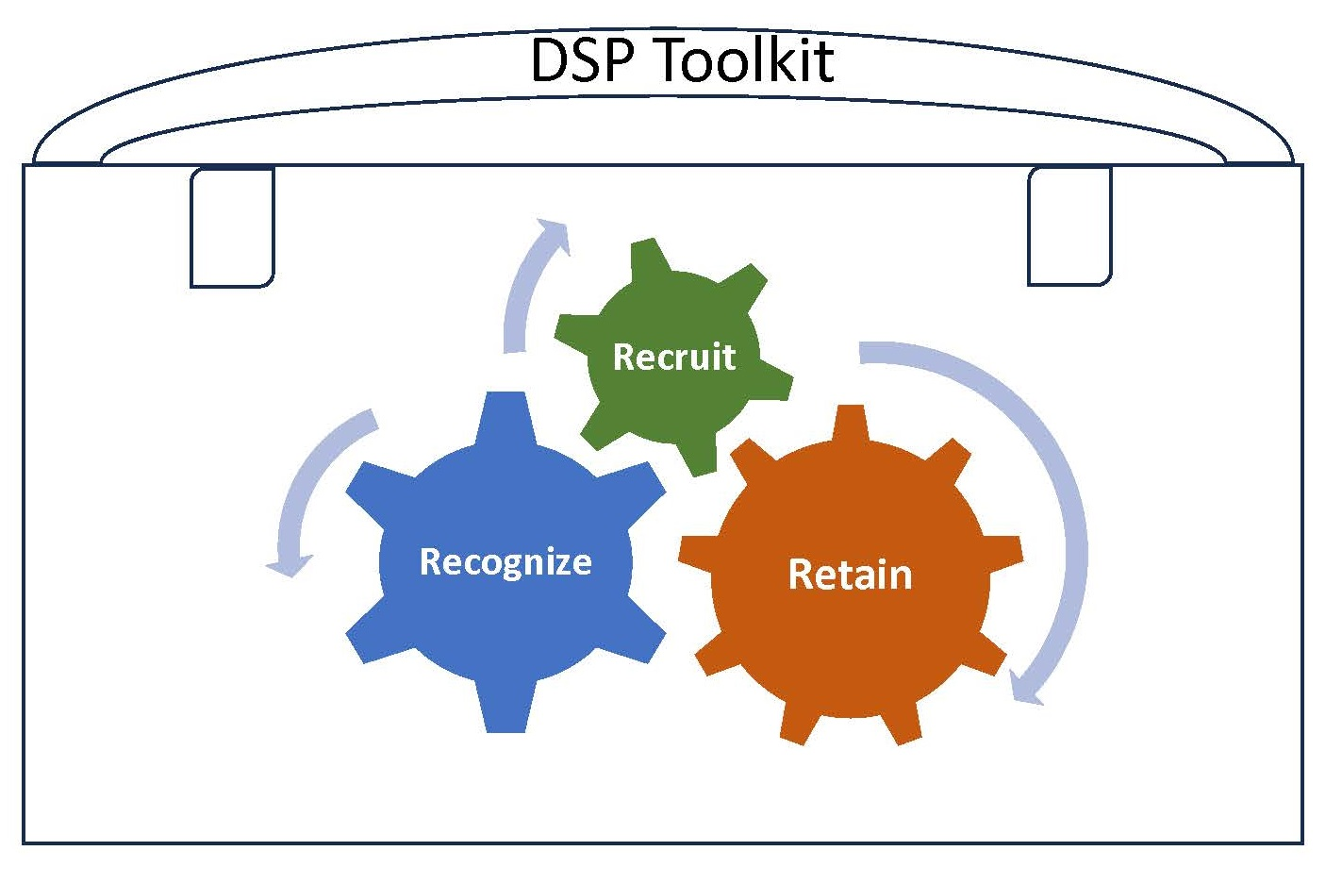
Phase 3 – Dissemination
Piloted Toolkit with 3 organizations – 4 resources were added because they were requested by pilot agencies
Toolkit is available online
Evaluating each resource
Provide Technical Assistance

Slide 11
Offshoots of this Project
GoodLife Workforce Strategies Training – March 27th
Apprenticeship Possibilities

Slide 12
Contact Us
Vanessa Krause Program Director Partners for Inclusive Communities University of Arkansas
Email: vanessas@uark.edu
Phone: (501) 912-4760

Slide 13
Let’s Stay Connected!
Like us on Facebook!
Follow us on Twitter!
Visit our Website!
Notes:
If you are not providing a digital version, then add the following below the links:
Facebook: @uofapartners
Twitter: @uofapartners
Website: uofapartners.uark.edu

