Slide 1
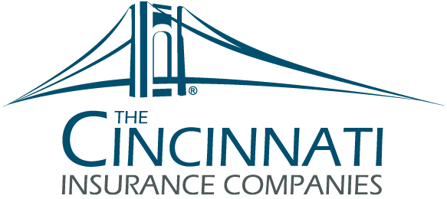
Role of Directors and Officers
Dion Young RPLU; Field=Representative Underwriter, Management Liability

Slide 2
Agenda
Basic Overview – Directors & Officers (D&O)
Importance of D&O Insurance for Nonprofit Boards
What Issues Place Officers at Risk of Claim
How Does D&O Insurance Protect Nonprofit Directors
Why Nonprofit Organizations Need Coverage More Than For-Profit Corporations
Counting the Cost of Not Purchasing D&O Insurance
Claim Examples

Slide 3
Directors & Officers Liability
D&O Liability coverage insures against claims alleging wrongful acts committed in the course of managing a business. The insured receives protection for covered claims, relieving the business and any insured person of the need to pay the significant costs of defense and potential settlements or judgements.
This coverage also protects the personal assets of the Directors and Officers when the organization is unable to indemnify or defend them.

Slide 4
Risk-Specific Policy Terms
Community Associations
Educators
Financial Institutions
Healthcare
Non-Profit
Privately Held
Publicly Held
Public Officials & Public Entity

Slide 5
Which Nonprofits Need D&O*
*Note that this list is not complete listing of non-profits with D&O exposure but is a representative sample.
DUTY (loyalty/obedience/diligence)
BREACH
CAUSE
HARM
Health and human services organizations(hospitals, clinics, nursing homes and social service organizations)
Education Institutions(such as schools, colleges, and universities)
Environmental and conservation organizations
Social advocacy and civil rights organizations
Charitable organizations that provide direct services to people in need (such as food banks and homeless shelters)
Foundations and grantmaking organizations
Research and scientific organizations
Trade and Professional associations
Public broadcasting and media organizations
Veteran and military organizations
Public safety and crime prevention organizations

Slide 6
The Importance of D&O Insurance for Nonprofit Boards
About 20% of all U.S. corporations are nonprofits.
Not all the board actions are covered by the federal Volunteer Protection Act. The Volunteer Protection Act is a federal law that protects volunteers against allegations of harm.
Nonprofit boards that fail to protect their organizations with a D&O insurance policy may find that the cost of just one claim is far larger than the cost of any insurance premiums they would have paid, if they had purchased a D&O insurance policy.

Slide 7
Does D&O Insurance Protect Nonprofit Directors
D&O insurance will not prevent claims from occurring; however, it does mitigate the high costs associated with defending claims. Lawsuits and potential claims may originate with vendors, donors, competitors, employees, government regulators or others.
D&O insurance policies are common and necessary to cover the actions and decisions of board directors and officers. D&O insurance policies offer coverage for defense costs, settlements, judgments arising from lawsuits and wrongful allegations brought against the nonprofit.

Slide 8
What Issues Place Directors and Officers at Risk of a D&O Claim
As Directors and Officers on a nonprofit board, you agree to accept the multitude of duties and responsibilities that come with the position. Such as setting the organizations policies and procedures which can open the door for allegations Board directors also deal with any major complaints or claims against the nonprofit.
Nonprofit organizations may receive complaints or allegations because of how they handle public relations, fundraising, budgeting and setting human resources policies.
Boards of directors have the broad responsibility of overseeing all programs and services of the nonprofit, which makes them liable for all essential operations of the organization.

Slide 9
Counting the Cost of Not Purchasing D&O Insurance
When someone chooses to make an allegation against a director or officer of a nonprofit organization, or against the organization itself, they don’t typically consider the size of the organization or whether it can afford potential damages.
Damages can be sizeable, and can easily exceed the net worth of many directors and officers
The litigiousness of our environment makes it necessary for nonprofit organizations of all sizes to secure D&O insurance.

Slide 10
D&O Common Claims Examples
Directors allegedly using organization funds for personal expenses.
Board decisions leading to a decline in donations.
Allegations of improper management decisions or actions that result in financial loss or harm to the organization or its stakeholders.
If your nonprofit is a membership-based operation, your business could be at risk for any discrepancy in membership standards. Any oversight or leniency you give a particular person could be seen as discrimination by those who did not receive the same treatment and standards.

Slide 11
Summary of Benefits of Directors and Officers Liability Insurance
Protecting Personal Assets
Attracting and Retaining High quality Board Members
Maintaining Financial Stabilty
Preserving the reputation of the organization
Encouraging Transparency and Accountability

Slide 12
Questions and Answers
Ask me anything.

