Slide 1
THE REDI
PROGRAM
Presented by:

Slide 2
Defining the Problem
According to the 2020 Disability Statistics Compendium, the employment participation rate for individuals ages 18-64 with disabilities is 32.8% compared to 76.9% of individuals without disabilities in the state of Arkansas.
In February 2021, the US Bureau of Labor Statistics reported 17.9% of individuals with disabilities were employed in 2020 compared to 61.8% for persons without disabilities.

Slide 3
Creating a Solution through the REDI
Career Training Pathway
With innovative solutions such as the REDI program that will aid in developing and supporting a willing population of individuals with disabilities to assist them in achieving their highest level of independence through the power of work.

Slide 4
(REDI)
WHAT REDI IS:
An in-store extern training program for people with disabilities to gain retail/customer service skills
A partnership between a store and the local disability community to increase the employability of people with disabilities.
An opportunity for a person with a disability to learn and develop skills to potentially become a qualified applicant for Walgreens.
Designed for people with disabilities who might otherwise not be considered qualified without the additional training provided by the program.
REDI is NOT:
An arrangement with a high school or community agency to give students/clients the "experience" of retail (also known as "work experience").
An initiative that gives stores additional hours or payroll budget.
A guarantee of employment for the externs.
A requirement for all people with disabilities to be hired.

Slide 5
Project Scope
REDI is currently in 38 states and continuing to grow. There is not a program in Arkansas. REDI is a training program, not a placement program. It is an opportunity for a person with a disability to learn and develop skills to potentially become a qualified applicant for positions with Walgreens or similar retailers. REDI is designed for people with disabilities who might otherwise not be considered qualified without the additional training provided by the program.

Slide 6
Retail Employees with
Disabilities Initiative (REDI)
Walgreens launched the program in 2010. The program’s goal is to prepare qualified candidates for employment at Walgreens retail locations, as well as employment with other retailers that require similar skills. It is an in-store extern training program that aims to help people with disabilities gain retail and customer service skills and work closely with communities, organizations, and vocational rehabilitation agencies to train and develop candidates.

Slide 7
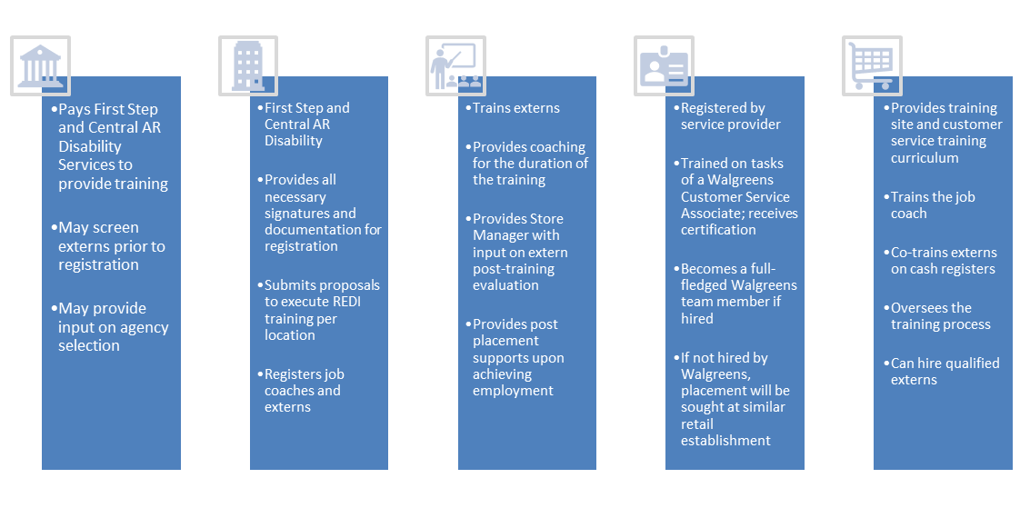
Stakeholder Roles

Slide 8
Regions
CADS
First
Step
Central Arkansas Disability
Services, Inc.
Region 1 Region 7
Region 2 Region 9
Region 3 Region 10
First Step, Inc.
Region 4 Region 6
Region 5 Region 8

Slide 9
Program Structure
Eligibility Determination
Admission into the REDI program consists of a multi-step determination process:
Potential Externs must have an open/active case with ARS
Completion of documentation required by ARS Field Office - RIDAC, Medical Assessment, Referral Letter, and Authorization for Services
All services related to REDI require prior written authorization by Arkansas Rehabilitation Services before services can be rendered and payment can be made.
Potential Extern must have a completed and approved application to the REDI program

Slide 10
Provider-Conducted Assessments
The assessment process includes an extensive intake interview to gather information on interests and needs, interest testing, customer service assessment and aptitude, reading and math levels, criminal background checks, and cash handling skills.
Meet physical requirements - bending, twisting, reaching, lifting 25-35 lbs., squatting, standing for 6-8 hours, climbing a ladder, reaching overhead, etc.
Soft skills such as interpersonal relationship skills, motivation, willingness to work, attendance, and punctuality.
Appropriate behaviors/manners in the workplace as well as professional environments.
There is no job carving available for this program.

Slide 11
Education and Training
Opportunity for REDI externs to attain retail-specific hard skills training is conducted through in-person training supported by provider staff and Walgreens.
Training Overview
Review Walgreens Expectations and Policies
Store Tour
Assigned Internal Employee Support
Customer Service
Cash Register
Stocking/Facing
Warehouse Truck Day
Merchandising
Mylars
Store Operations
Multi-tasking

Slide 12
SOFT SKILLS
This training will consist of a series 11 of instructor-led modules delivered by CADS and First Step staff:
Initiating Discussions with Coworkers and Supervisors
Interpreting Facial and Body Expressions
Monitoring Your Voice at Work
Self-maintenance and Appropriateness
Maintaining Self Control
Handling Inappropriate Behavior
Getting Along with Your Coworkers
Being a Team Player
Following Directions
Communicating Needs to Supervisors and Coworkers
Responding to Positive and Constructive Feedback

Slide 13
Successful Completion of Program
The Store Manager will complete the final evaluation, to determine if an extern has mastered the skills required of a Walgreens Customer Service Associate. Those meeting the required grade point will receive a recommendation for hire as a Customer Service Associate at the completion of the program.
The program will prepare externs to work in a retail environment. Successfully completing the REDI Program does not guarantee employment at Walgreens.
Upon successful completion, each Extern will be provided with a certificate of completion and the opportunity to participate in the REDI graduation ceremony.
If not hired by Walgreens the extern will remain on Walgreens prospective list for hire for up to 6 months; however, the extern can pursue other employment with other retail stores.

Slide 14
Assessment:
The job coaches will provide weekly assessments to support Walgreens managers in evaluating the comprehension and skill level of the externs at the completion of the program
Externs will receive a certificate of completion at the end of the sessions

Slide 15
Contact Us!
SUPPORTED EMPLOYMENT SERVICES
peggy.beggs@fstep.org 501-609-9356
fedington@cadsinc.net 501-537-1080 ext.108

Slide 16
Thank You!

