Slide 1
LTSS Workforce Development
Ashley Riedmueller & Jessica Walker
COMPANY CONFIDENTIAL | FOR INTERNAL USE ONLY | DO NOT COPY

Slide 2
Agenda
Introductions
Define Workforce Development
Identify presenting staffing issues and barriers
Next steps – how Summit plans to help
Employee surveys
Elsevier
IntellectAbility
Questions

Slide 3
What is Workforce Development?
A collaborative approach between Summit Community Care and our Contracted Providers to improve outcomes of members by enhancing the knowledge, skills, and competencies of the direct support professional (DSP) workforce.
The ability to achieve this goal is highly dependent on finding solutions to the workforce challenges faced by individuals, families, and organizations who employ DSPs.

Slide 4
Identifying and analyzing the trends
Data collection and analysis of your standard practices
Current retention information
Current wages
Cost of new hires
Number of open positions and how long those positions have been open
Hear from multiple stakeholders
Employee surveys
People-supported surveys (focus on questions about their care)
Focus groups (include more than just management in these groups – combination of management, direct care staff and people supported)

Slide 5
Provider input
What is working in finding and hiring DSPs?
What barriers are you seeing specifically?
Do you have thoughts on how to resolve these barriers?

Slide 6
Quick-er potential resolutions
Things you can do today to make a change now:
Frequency of pay – salary, transportation reimbursement
Means of communicating open positions – platforms being accessed
Indeed, local newspapers, Handshake, social media
Posting open positions at members’ places of interest i.e. Bass Pro, bowling alley, skateboard shop, library
Upping the ad game
Schedule changes
Thinking outside of Monday-Friday, overnights, weekends
Additional training/knowledge
Providing specific training to DSPs they feel would enhance their work environment and ability to provide care to our members

Slide 7
Intervention strategy
Use collected data to prioritize your next steps:
Recruitment – how do we find new workers?
Employee selection – matching employees with the people served.
Orientation and onboarding – ensuring employees feel welcome and connected immediately in their new roles.
On-going training and development – ensuring employees have the skills, knowledge, and opportunity for development.
Management training – ensuring management has the skills and knowledge to effectively manage their direct reports/team.

Slide 8
Barriers
Change can be hard.
What are some potential barriers you may have to implement these changes?
In your focus groups and discussions with the team, make sure these barriers are recognized and discussed.
Lack of resources is a common barrier for implementation of change:
Money
Materials
Knowledge
Capacity
Planning and organization can help manage any barriers present.

Slide 9
Workforce development plans
Oversee the development of contracted provider workforce.
Monitor and collect information on the workforce.
Plan workforce development activities including the recruitment and employment of members as appropriate.
Provider direct assistance to provider network to support the development of their respective workforce.
Ensure members receive services from a workforce that is qualified, competent, and sufficiently staffed.
Analyze current and future healthcare trends.
Forecast the workforce capacities and competencies needed to address these trends.
Monitor of the overall performance of the provider network.

Slide 10
Workforce development plans
Transform the system from compliance-driven training to a competency-based systems approach.
Create an understanding of the skill sets and competencies essential for a competitive workforce.
Improve member outcomes, increased staff retention and satisfaction, and enhanced quality of service provided.
Obtain a stable, reliable, and well-trained direct support workforce to be able to provide community support to the individuals we serve.
Develop training modules for leadership and management trainings.

Slide 11
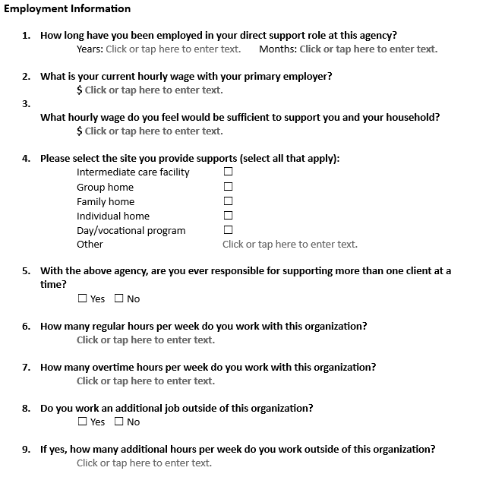
Employee survey project

Slide 12
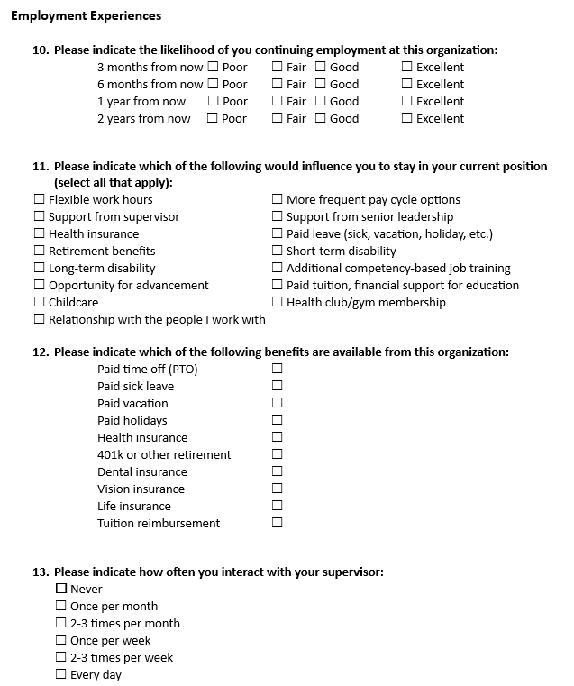
Employee survey project

Slide 13
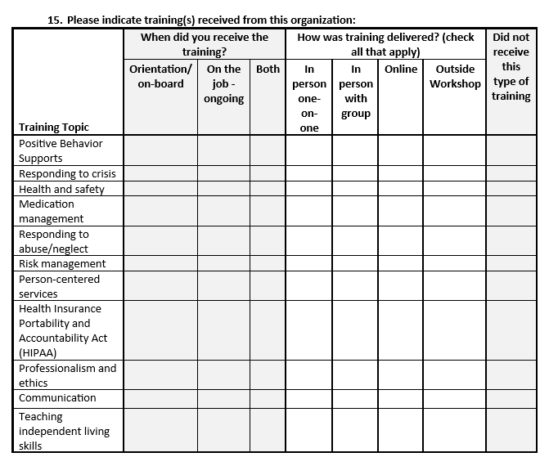
Employee survey project

Slide 14
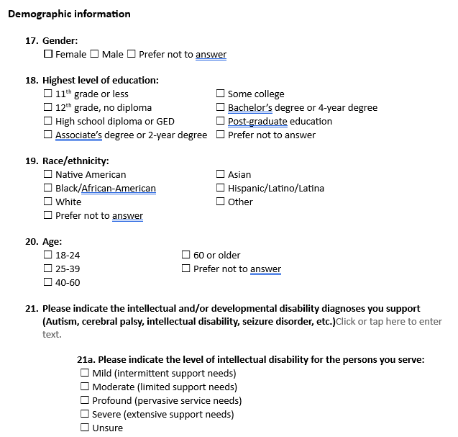
Employee survey project

Slide 15
Elsevier – what is it?
Elsevier is the world’s leading health sciences publisher, bringing a wealth of technology and content expertise to today’s human services organizations.
The Elsevier Performance Manager (EPM), trusted by more than 1,500 organizations and 2.5 million professionals worldwide, is the platform that powers DirectCourse.
The EPM Delivers and tracks training with any DirectCourse curriculum in addition to any Elevance Health created or procured content.

Slide 16
Elsevier – DirectCourse
DirectCourse provides standardized, tailored online training to empower the direct service workforce and their mission to help others lead meaningful lives within their communities.
Course curriculum is developed through a university-based research and training center that has been recognized by the National Institute on Disability and Rehabilitation Research (NIDRR), as well as peers in their field, as being a leader of thought, study, and discovery.
Focused on creating a coherent foundation of knowledge, skills, and abilities within the direct support workforce, and then building on that foundation.

Slide 17
Elsevier

Slide 18
Elsevier partners

Slide 19
IntellectAbility

Slide 20
IntellectAbility
The Fatal Five – The top preventable causes of illness and death in people with IDD – aspiration, constipation/bowel obstruction, seizures, dehydration, sepsis, and gastroesophageal reflux
Actions Speak Louder than Words – Understanding how adverse behaviors are frequently signs of treatable medical conditions
Physical and Nutritional Supports – Understanding techniques to improve nutrition and functional status of people in support
Choking Prevention and Management – Specifically geared information to reduce choking risk and teach what to do in various circumstances to assist someone who is choking
Person-Centered Thinking – Covers essential concepts needed to effectively deliver person-centered supports

Slide 21
IntellectAbility – DSP recognition

Slide 22
LTSS Contacts
Brittany Davis – Director of Provider Relationships, LTSS
Brittany.Davis@summitcommunitycare.com
501-446-8625
Brandon Boyd – Provider Relations Representative, A-J
Brandon.Boyd@summitcommunitycare.com
501-200-7493
Rachelle Sigler – Provider Relations Representative, K-Z
Rachelle.Sigler@summitcommunitycare.com
501-442-6420
Ashley Riedmueller – Workforce Development Manager
Ashley.Riedmueller@summitcommunitycare.com
501-289-9297
Jessica Walker – LTSS Provider Education Specialist
Jessica.Walker@summitcommunitycare.com
501-412-0462

